Slide 1
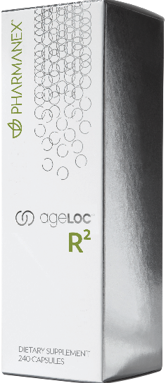
AGELOC R²
Notes:
Title slide

Slide 2
Are you ready to feel and live younger? To remind your body to act young again?
You’re Not Alone…
Notes:
Are you ready to feel and live younger? To remind your body how to act young again? To experience the freedom of your mind and
body working together at their absolute best? You’re not alone. One noticeable sign of aging is we lose our youthful spark: we begin
to feel flat, sluggish, and out of tune.

Slide 3
SURGING GLOBAL ANTI-AGING MARKET
$274.5 Billion in 2013 with double digit growth rates for the next decade
BCC Research, May 2009

Slide 4
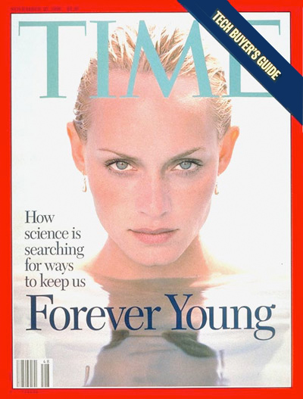
KEY MARKET DRIVERS
Increasing aging population wanting to stay young
Consumers seeking anti-aging at increasingly younger ages
Increased consumer spending
Consumers willing to pay premium prices
Global media increasing awareness

Slide 5
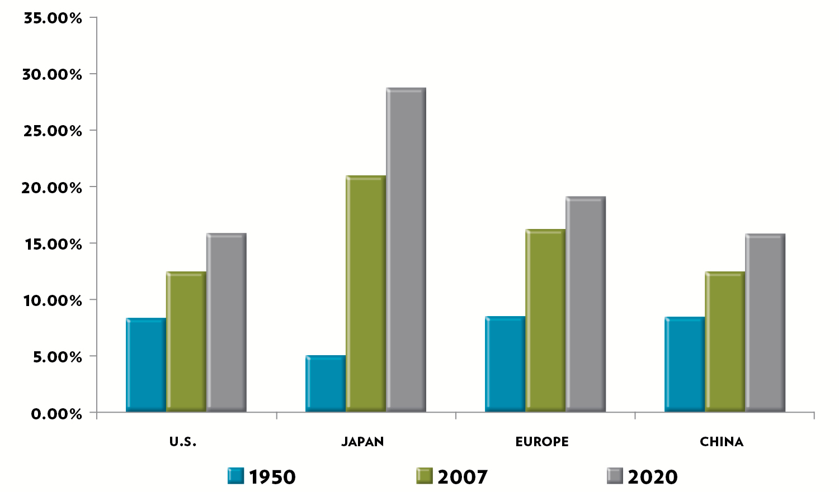
AGING POPULATION
Over-65 Population Will Double by 2050
Kinsella, Kevin and Wan He. U.S. Census Bureau and National Institute on Aging. International Population Reports. An Aging World: 2008, U.S. Government Printing Office, Washington, DC. 2009.
Notes:
The global over-65 population will double by 2050

Slide 6
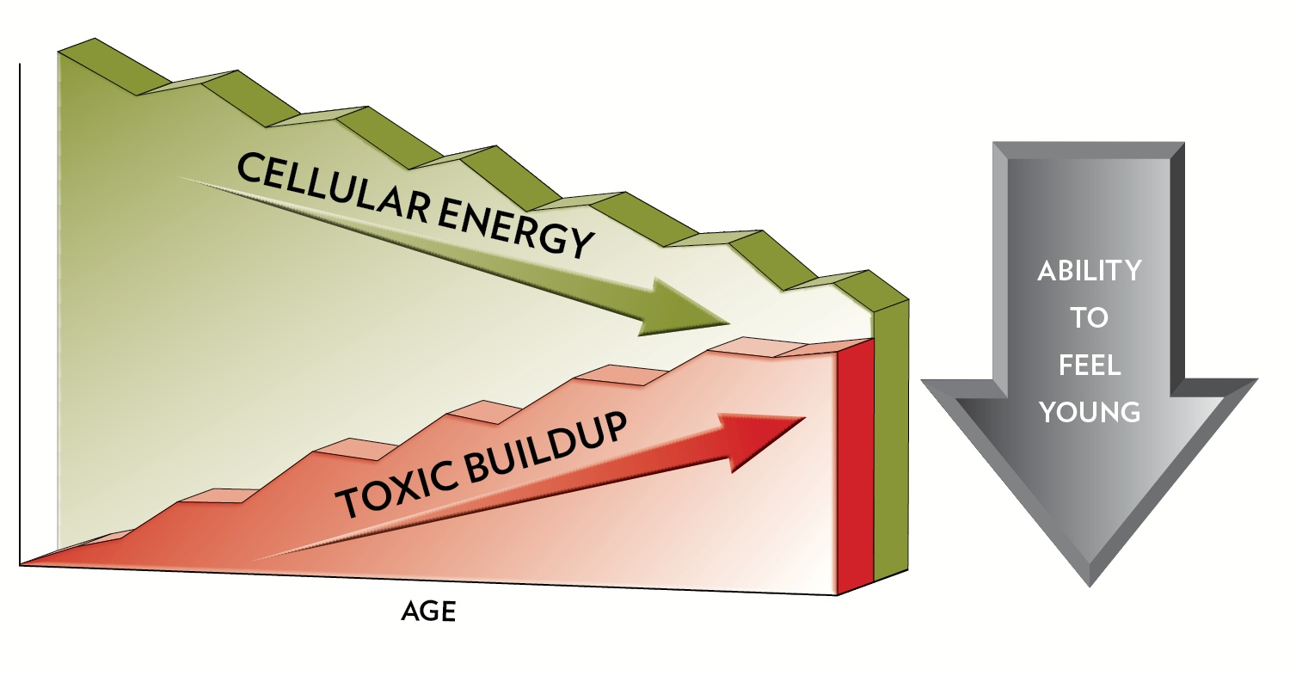
AGING’S ONE-TWO PUNCH
Gene expression changes lead to:
Decline in cellular energy production
Increase in cellular waste and toxic byproducts
This graph is a hypothetical representation of cellular energy decline and toxic buildup over time and DOES NOT represent any actual experimental data.
Notes:
One of the most noticeable signs of aging is that we lose our youthful spark: we begin to feel flat, sluggish, and out of tune. Why? Aging’s one-two punch is the result of changes in YGCs leading to cellular energy production declines and buildup of cellular waste and toxic by products. This affects our ability to feel young.

Slide 7
LEADS TO A DOWNWARD SPIRAL
Cellular Energy
Declines
—Cellular Purification Declines
Cellular Energy—
Declines
—Cellular Purification Declines
Cellular Energy—
Declines
—Cellular Purification Declines
Cellular Energy—
Declines
—Cellular Purification Declines
Lose the Ability to Feel Young
Notes:
This is in part due to this cyclical process that leads to internal toxic burden and a loss of vitality. When these processes aren’t working in harmony, they have the potential to impact the other, creating a downward spiral that slows the body’s ability to function well and makes it difficult to feel like we did when we were young.

Slide 8
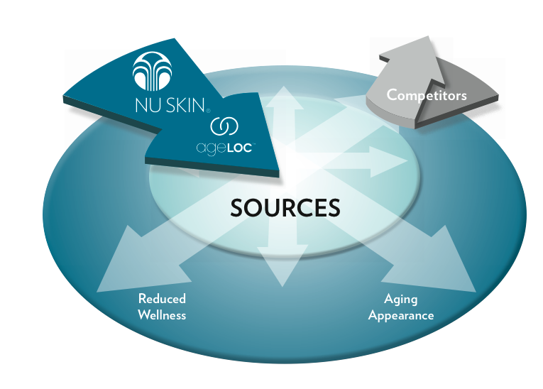
THE KEY TO YOUTH IS IN OUR GENES
Notes:
This is where we’ve asked science to step in. Competitors merely address the signs and symptoms of aging, such as an aging appearance or reduced wellness. ageLOC Science targets the sources of aging (genes), not just the symptoms.

Slide 9
AGELOC SCIENCE HAS THE ANSWER
Identify, Target and Reset the Youth Gene Clusters related to:
Cellular Energy Production
Cellular Purification
Notes:
ageLOC R2 is a powerful product combination that works by targeting and resetting the YGCs related to cellular energy production and cellular purification.

Slide 10
STARTING TODAY, YOU HAVE THE POWER TO FEEL YOUNG AGAIN
Notes:
Starting today, you have the power to feel young again.

Slide 11
INTRODUCING AGELOC R²
Notes:
ageLOC R-Squared targets the source of aging to retune and reset your youth—helping you to feel healthier, younger, and more vibrant than you have in years. If you want to feel younger longer, you need ageLOC R-Squared.

Slide 12
AGELOC R²
NIGHT
Cellular Purification and Cleansing
DAY
Physical, Mental
& Sexual Vitality
Notes:
Taken in the evening, ageLOC R2 Night optimizes each cell’s natural purification process, helping you start each day refreshed and renewed. Taken in the morning, ageLOC R2 Day optimizes cellular energy production to help you recharge and take control of a new day.

Slide 13
RENEWED
Feel young and energized, full of vitality
Wake up each day feeling refreshed and renewed
RECHARGED
Notes:
The result? Wake up each day feeling refreshed and renewed; Feel young and energized, full of vitality. Who doesn’t need that?

Slide 14
PRODUCT ADVANTAGE
Targets the sources of aging rather than
the symptoms, for example:
Cellular cleanse vs. colon cleanse products
Raise baseline energy levels vs. temporary energy boost products
Notes:
R-Squared is unique in the industry because it (1) targets the sources of aging, and (2) combines the synergy of cellular energy and cellular purification for an overall feel young benefit. For example, unlike a colon cleanse, which is limited to the GI tract and only targets some systems and symptoms, we are providing a cellular cleanse, which focuses on the source of toxic burden by targeting the YGC associated with cellular purification. Similarly, common energy boost products provide a temporary “pick-me-up” and then a crash, while R-Squared is focused on raising baseline energy levels over time.

Slide 15
RECOMMENDED USE
For men and women who have ever felt
flat, sluggish, and out of tune, and who
want to feel young again.
ageLOC R² Night
Take two (2) capsules in the evening
ageLOC R² Day
Take six (6) capsules in the morning
Notes:
The target customer for R-Squared? Men and women who have ever felt flat, sluggish, and out of tune, and who want to feel young again.
Take six (6) ageLOC R2 Day capsules in the morning. Take two (2) ageLOC R2 Night capsules in the evening.

Slide 16
LIFEPAK—THE PERFECT COMPANION
Must have nutritional foundation for optimal gene expression
LifePak® provides that foundation
Nutrients critical for cellular purification and cellular energy
Dietary antioxidants for added protection from oxidative stress
Notes:
LifePak and LifePak Nano are the perfect companions to ageLOC R² because optimal gene expression requires good nutrition for cellular purification and cellular energy production. LifePak/LifePak Nano provides critical nutrients needed for the body’s purification and energy production systems and for optimal cellular function. It also provides dietary sources of antioxidants for added protection from oxidative stress.

Slide 17
AGELOC
Resetting YGCs on the outside and the inside delivers a beautiful blend for the look and feel of youth.
Notes:
ageLOC™ Skin Care Products are great companions to ageLOC R² because resetting YGCs on the outside and the inside delivers a beautiful blend for the look and feel of youth.

Slide 18
AGELOC R²
Renew and
Recharge
your life.
Notes:
Renew and recharge with ageLOC R-Squared

Slide 19
SECTION TWO
BACKGROUND ON CELLULAR ENERGY PRODUCTION AND CELLULAR PURIFICATION
Notes:
Section two – background on cellular energy and cellular purification

Slide 20
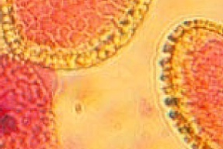
YOUTHFULNESS
From Genes to Cells to Organisms
Organisms Level
Youthful feeling
Cellular Level
Productivity of the cell
Genetic Level
YGCs expressed at youthful levels
Notes:
The purpose of this slide is to connect youthfulness on its various levels.
The key to youth is in our genes. As we age, the expression of our genes, or the way our genes communicate with our cells, changes. This can diminish our cells’ ability to function at their peak. The productivity of our cell impacts how we feel. When trillions of our cells feel sluggish, it’s no wonder that we may also feel worn down and tired.

Slide 21
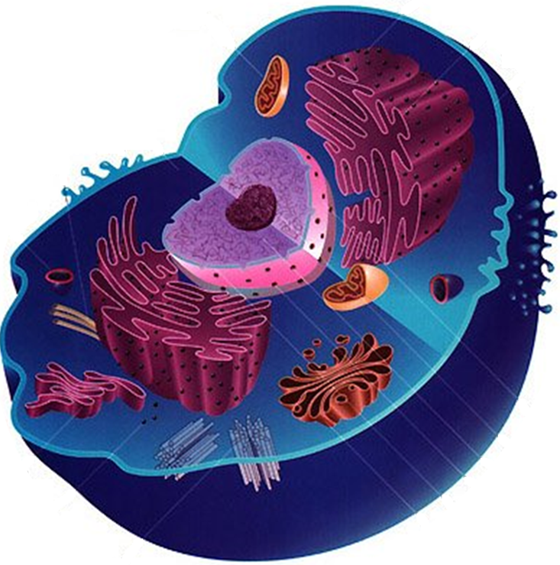
YOUTHFUL CELLULAR FUNCTION
ATP: our body’s fuel source for energy
Cellular Energy Production
+
ATP
Cellular Purification
Toxins & waste: a byproduct of normal cellular metabolism
Notes:
Our cells function optimally when we are young. However, as we age, our cells do not function as well as in our youth. This aging phenomenon is in part the result of the changing expression of our YGCs related to cellular purification and cellular energy. ATP is the byproduct of cellular energy production, as our body’s fuel source for energy. Toxins and waste are a byproduct of normal cellular metabolism, and are managed through our cellular purification process.

Slide 22
CELLULAR ENERGY
ATP
Cellular Energy Production:
Mitochondria powers all cell functions
Converts energy from food into a form of energy our cells can use— ATP
Notes:
To target cellular energy production, one must focus on the mitochondria. Deep inside each of our cells, as tiny cellular “power plants” called mitochondria convert the energy from our foods into a form of chemical energy (ATP) that fuels our bodies.

Slide 23
MITOCHONDRIAL ACTIVITY DECLINES WITH AGE
Mitochondrial Oxidative Activity
mmol/g of muscle/min
8
6
- 40%
4
2
18~39
61~84
“Mitochondrial Dysfunction in the Elderly: Possible Role in Insulin Resistance” Science 16 May 2006; vol 300, no 5622, pp 1140-42
Notes:
As we age, the efficiency, size, and number of our mitochondria declines and energy production is unable to keep up with our bodies’ demands. As seen in this graph, mitochondrial activity declined 40% from youth to older age. The loss of vitality as we age is associated with age-related changes in the YGC related to cellular energy production.

Slide 24
CELLULAR PURIFICATION
Cellular Purification:
Removes cellular waste and toxic byproducts
Protects cell structures from toxin-induced damage
Repairs cell structures
Notes:
Our body’s intricate cellular purification system involves multiple pathways and processes within our cells. Rather than focusing on one organ, such as the liver, a focus on the source of purification takes us to the cellular level. While this system is very complex, it can be summarized into three primary functions – (1) removing cellular waste and toxic by-products; (2) protecting cell structures from toxin-induced damage, and (3) repairing cell structures.

Slide 25
AGE-RELATED TOXIC BURDEN
In youth, cell’s ability to purify itself exceeds the toxic load
With aging, toxic load exceeds cell’s ability to purify
Internal Toxic Load
Cellular Purification System
Internal Toxic Load
Cellular Purification System
External Toxic Load
External Toxic Load
Youthful Cell
Aging Cell
Internal Load = Cellular waste and toxic byproducts
External Load = Environmental contaminants
This graph is a hypothetical representation of cellular purification and toxic load over time and DOES NOT represent any actual experimental data.
Notes:
When we are young, our cell’s ability to purify exceeds the toxic load. Unfortunately with aging, our bodies become less effective at purifying and our exposure to cellular waste and toxic byproducts increases. As you can see, exposure to environmental toxins is relatively fixed with age, but with age, the internal load increases, which can increase our toxic burden and accelerate the aging process.

Slide 26
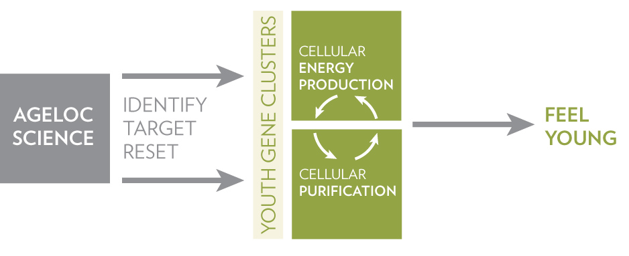
TARGETING YGCS FOR YOUTH
Notes:
ageLOC science resets the cellular purification and cellular energy production YGCs toward a more youthful gene expression pattern, which leads to these processes functioning optimally.

Slide 27
THANK YOU

