Slide 1
ageLOC® Dermatic Effects
Body Contouring Lotion

Slide 2
Objectives
After viewing this training module, you should have an understanding of the following:
Basics of ageLOC and targeting Youth Gene Clusters.
The signs of ageing on the body.
Key ingredients and benefits of ageLOC Dermatic Effects.

Slide 3
Introduction
Like other organs of the body, the physiological functions and structures within the skin continuously decline with ageing.
Most individuals focus on the appearance of their facial skin, but the skin on the body also shows signs of ageing.

Slide 4
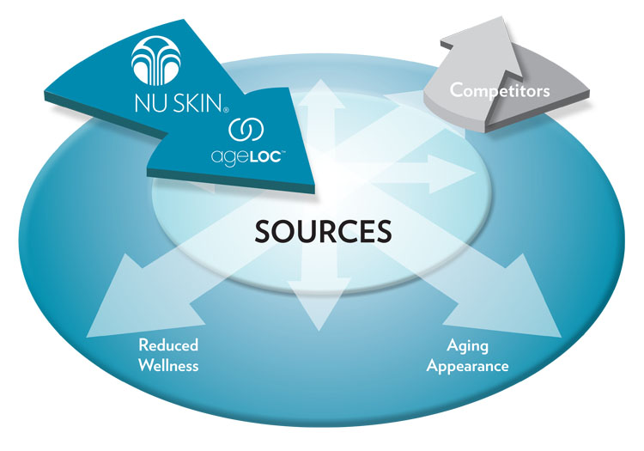
Ultimate Sources of Ageing
Ageing can ultimately be linked back to genes. The expression of our genes is a contributing factor to ageing. A person’s genetic makeup and gene expression profiles, combined with many other ageing factors, including environmental exposure, determines how quickly he or she will age—both internally at the cell level and externally by skin appearance.

Slide 5
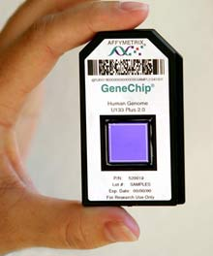
arSuperMarker—Youth Gene Clusters
Based on an understanding of the human genome, Nu Skin scientists have been able to identify through proprietary ageLOC Science an important arSuperMarker, Youth Gene Clusters (YGCs). YGCs are functional groups of genes whose expression can be regulated to provide a youthful gene expression profile of a specific attribute.

Slide 6
arSuperMarker—Body YGC
Nu Skin scientists identified a Body YGC for the skin. Based on current scientific research and our clinical findings, mechanisms of action that contribute to ageing appearance on the body include:
Breakdown of structural proteins
Increase of lipogenesis while lipolysis decreases
Decrease in circulation
Decrease in moisturisation

Slide 8
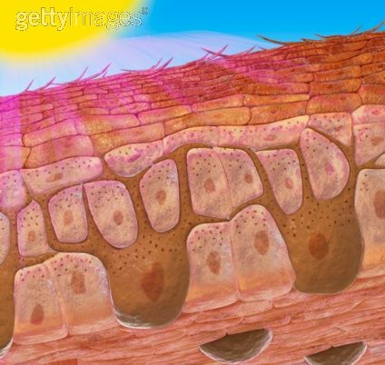
Interaction of Biological and Environmental Ageing
Ultimately, ageing is a combination of both our biology and our environment. And the free radical theory of aging is still relevant and contributes to our ageing.
Free radicals from internal and external sources can damage not only skin structures but also our genes.

Slide 9
Loss of Youthful Appearance
As we age, we lose our youthful appearance. We no longer have the firm, lifted, smooth, slim shape we once enjoyed. Certain skin areas may have succumbed to increased cellulite and a lack of firmness. The moisture barrier on our skin may have become compromised resulting in dryness.

Slide 10
Loss of Youthful Shape
When the skin lacks structural proteins, it loses it’s smoothness and firmness.
Lacking this structure on the body allows the protrusion of fat into the dermis to be increasingly visible.
Topographically, the skin becomes dimpled, giving it the appearance of an orange peel or mattress.

Slide 11
Turning Back Your Skin’s Clock
Even if you did not properly care for your skin in years past, there are many technologically advanced ingredients that help repair the visible signs ageing.

Slide 12
ageLOC Dermatic Effects
For a more contoured, smoother looking you. Scientifically formulated to bring ageLOC anti-ageing benefits to the body every day, ageLOC Dermatic Effects helps smooth the appearance of fat and cellulite and improve the appearance of skin firmness. This daily contouring moisturiser helps increase cellular turnover, returning skin to its natural radiance. It also hydrates and utilises leading edge optical technology to diffuse light instantly, helping skin look smoother while improving the appearance of the skin’s surface.

Slide 13
Key Benefits
ageLOC targets the ultimate sources of ageing to preserve the look of youth and reduce the appearance of ageing.
Contains ingredients that help inhibit fat production and stimulate fat breakdown.
Helps smooth the appearance of fat and cellulite for a more contoured looking body.
Improves appearance of skin’s firmness for a more youthful look.
Helps increase cellular turnover, which is necessary for renewing the skin and returning it to its natural radiant texture.
Leading edge optical technology diffuses light instantly to help skin look smoother and improve the appearance of the skin’s surface.
Hydrates and helps smooth the skin.

Slide 14
Key Ingredients
ageLOC®—proprietary Nu Skin® technology that targets arSuperMarkers, the ultimate sources of ageing.
Hibiscus abelmoschus extract—rich in plant lipid extract that helps calm free radicals and inhibit the appearance of cellulite.
Honey extract—a natural alpha-hydroxy acid to help smooth and soften skin.
Hyaluronic acid—helps maintain an optimal moisture level.

Slide 15
Key Benefits Supported

Slide 16
Key Benefits Supported
ageLOC targets the ultimate sources of ageing to preserve the look of youth and reduce the appearance of ageing.
Based on the discovery of arSuperMarkers, ageLOC science is utilised to help validate products that target the sources and signs of ageing. Our scientists have been able to identify, through ageLOC science and research, ingredients that have a positive impact on arSuperMarkers including Youth Gene Clusters. By combining ageLOC science, which targets the sources of ageing, with cutting-edge corrective anti-ageing ingredients, which reduce the visible signs of ageing, Nu Skin® products provide a preventative and corrective approach to maintaining and promoting youthful skin.

Slide 17
Key Benefits Supported
Contains ingredients that help inhibit fat production and stimulate fat breakdown.
Hibiscus abelmoschus extract has been found to stimulate the breakdown and inhibit the production of fat. This botanical extract has been shown to activate a receptor responsible for stimulating the breakdown of fat (lipolysis) while also blocking the receptor that stimulates fat production (lipogenesis). This two pronged approach is found to be effective against stubborn cellulite.
ageLOC Dermatic Effects featuring hibiscus abelmoschus extract helps smooth the appearance of fat and cellulite and improve the appearance of skin firmness.

Slide 18
Key Benefits Supported
Helps smooth the appearance of fat and cellulite for a slimmer looking body.
Cellulite is a protrusion of fat into the dermis that is topically visible. With age the skin’s structural proteins continue to be degraded and their production slows. When the skin’s overall structure is diminished, fat protrusions can become increasingly visible.
ageLOC Dermatic Effects is formulated with ingredients that inhibit fat synthesis and increase fat breakdown but also help to promote the production of structural proteins. These ingredients allow ageLOC Dermatic Effects to help smooth the appearance of fat and cellulite, resulting in a slimmer, more youthful looking body.

Slide 19
Key Benefits Supported
Improves appearance of skin's firmness for a more youthful look.
Fibroblasts are specialised cells in the skin that produce structural proteins that contribute to smooth, contoured skin. Research has shown that cosmetic ingredients can act as messengers between cells and promote fibroblast activity to help repair skin damage that comes with age. Formulated with this technology, ageLOC Dermatic Effects can improve skin firmness and youthful appearance.

Slide 20
Key Benefits Supported
Helps increase cellular turnover, which is necessary for renewing the skin and returning it to its natural radiant texture.
Cellular turnover tends to slow with age, allowing older, dull cells to remain at the skin’s surface. ageLOC Dermatic Effects is formulated with honey extract, a natural source of hydroxy acids, to enhance cellular turnover. It also has a low pH which further supports this mechanism for renewing skin and returning it to it youthful radiance.

Slide 21
Key Benefits Supported
Leading edge optical technology diffuses light instantly to help skin look smoother and improve the appearance of the skin’s surface.
When the skin’s surface is uneven, light is not reflected uniformly and shadows are cast allowing the eye to see the varying topography. By utilizing anti-shine ingredients that flatten and diffuse light in multiple directions, the skin instantly appears smoother. This optical manipulation visually improves the appearance of the skin’s surface.

Slide 22
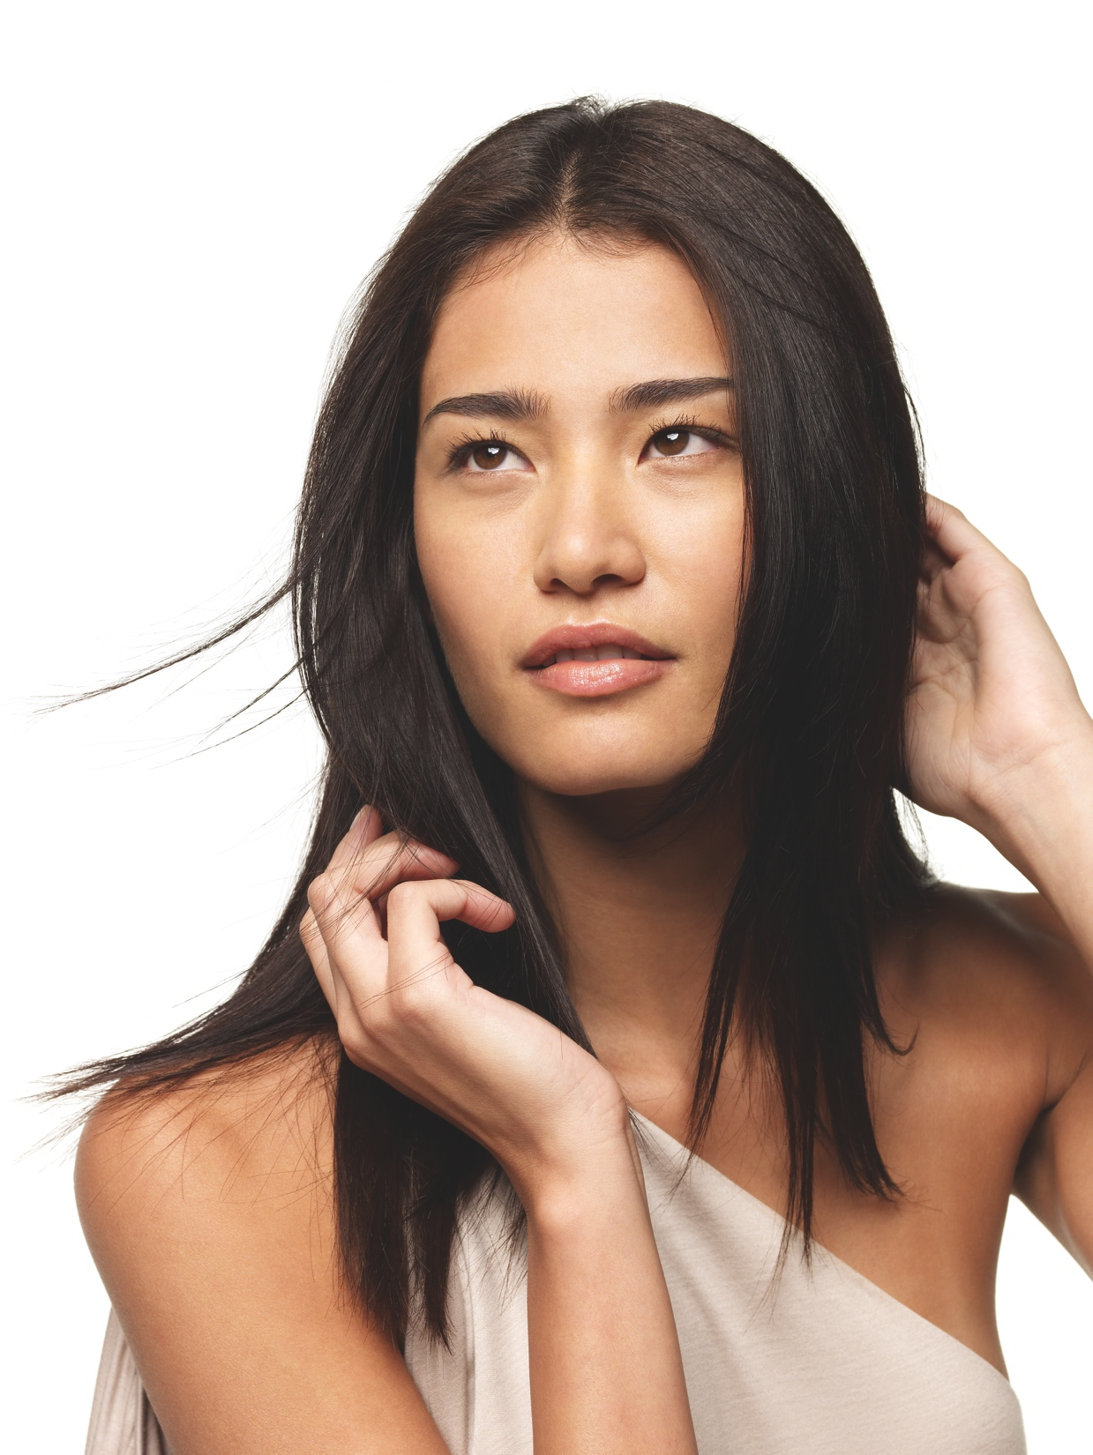
Key Benefits Supported
Hydrates the skin while
helping smooth.
Formulated with skin moisturisers including hyaluronic acid, alpha-hydroxy acid, aloe, and algae extract, ageLOC Dermatic Effects hydrates and helps smooth the skin.

Slide 23
Usage
Apply twice daily, morning and night to arms, thighs, buttocks, and/or abdomen. For best results combine with your ageLOC Body Shaping Gel regimen.

Slide 24
Target Audience
Primary Markets:
Women and men looking for a firmed, toned, younger-looking body.
ageLOC Galvanic Body Spa and Galvanic Spa customers.
Secondary Markets:
Image conscious women, ages 25-65, who may occasionally visit day spas.
Women of any age with cellulite and other signs of ageing on the body.

Slide 25
Complementary Products
ageLOC® Body Shaping Gel—formulated to work exclusively with Nu Skin Galvanic Spa instruments to bring ageLOC anti-ageing benefits to the body, smooth the appearance of fat and cellulite, and help increase cellular energy to help refresh and purify while reducing the visible signs of ageing.
Liquid Body Lufra—revitalises and gives skin a luminous glow as you shower. Finely ground walnut shells buff out rough spots on elbows, backs of arms, knees, heels, and all over. With Liquid Body Lufra, you step out of the shower with smoother, softer skin.

Slide 26
Review
Key Benefits
ageLOC targets the ultimate sources of ageing to preserve the look of youth and reduce the appearance of ageing.
Contains ingredients that help inhibit fat production and stimulate fat breakdown.
Helps smooth the appearance of fat and cellulite for a slimmer looking body.
Improves appearance of skin's firmness for a more youthful look.
Helps increase cellular turnover, which is necessary for renewing the skin and returning it to its natural radiant texture.
Leading edge optical technology diffuses light instantly to help skin look smoother and improve the appearance of the skin’s surface.
Hydrates and helps smooth the skin.

Slide 27
ageLOC® Dermatic Effects
Body Contouring Lotion

