Slide 1
ageLOC® Body Shaping Gel

Slide 2
Objectives
After viewing this training module, you should have an understanding of the following:
Basics of ageLOC and targeting Youth Gene Clusters.
The signs of ageing on the body.
Key ingredients and benefits of ageLOC Body Shaping Gel.

Slide 3
Introduction
Like other organs of the body, the physiological functions and structures within the skin continuously decline with ageing.
Most individuals focus on the appearance of their facial skin, but the skin on the body also shows signs of ageing.

Slide 4
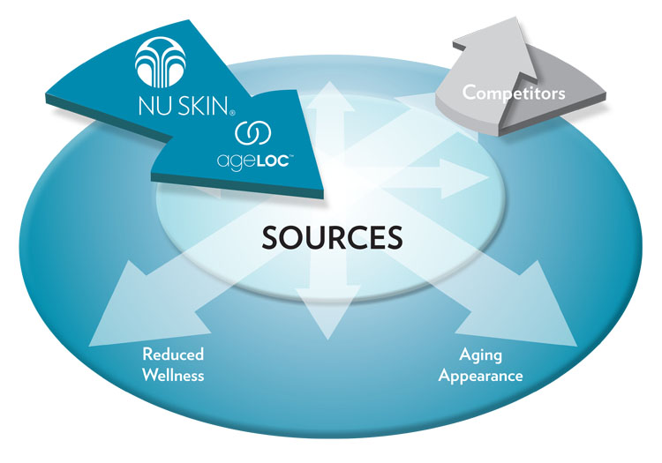
Ultimate Sources of Ageing
Ageing can ultimately be linked back to genes. The expression of our genes is a contributing factor to ageing. A person’s genetic makeup and gene expression profiles, combined with many other aging factors including environmental exposure, determines how quickly he or she will age—both internally at the cellular level and externally by skin appearance.

Slide 5
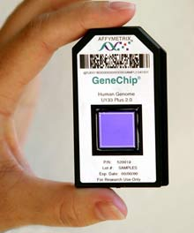
arSuperMarker—Youth Gene Clusters
Based on an understanding of the human genome, Nu Skin scientists have been able to identify through proprietary ageLOC Science a key arSuperMarker, Youth Gene Clusters (YGCs).
YGCs are functional groups of genes whose expression can be regulated to provide a youthful gene expression profile of a specific attribute.

Slide 6
arSuperMarker—Body YGC
Nu Skin scientists identified a Body YGC for the skin. Based on current scientific research and our clinical findings, the mechanisms of action that contribute to aging appearance on the body include:
Breakdown of structural proteins
Increase in lipogenesis while lipolysis decreases
Decrease in circulation
Decrease in moisturisation

Slide 8
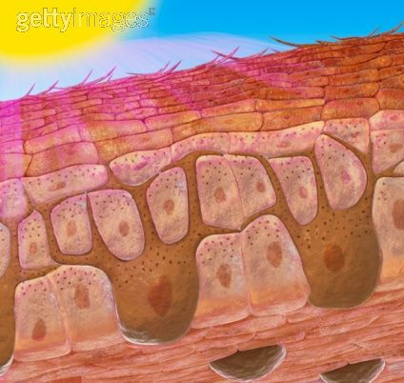
Interaction of Biological and Environmental Ageing
Ultimately, ageing is a combination of both our biology and our environment. And the free radical theory of ageing is still relevant and contributory to our ageing.
Free radicals from internal and external sources can damage not only skin structures but also our genes.

Slide 9
Loss of Youthful Appearance
As we age, we lose our youthful appearance. We no longer have the firm, lifted, smooth, slim shape we once enjoyed. Certain skin areas may have succumbed to increased cellulite and a lack of firmness. The moisture barrier on our skin may have become compromised resulting in dryness.

Slide 10
Loss of Youthful Shape
When the skin lacks structural proteins, it loses it smoothness and firmness.
Lacking this structure on the body allows the protrusion of fat into the dermis to be increasingly visible.
Topographically, the skin becomes dimpled, giving it the appearance of an orange peel or mattress.

Slide 11
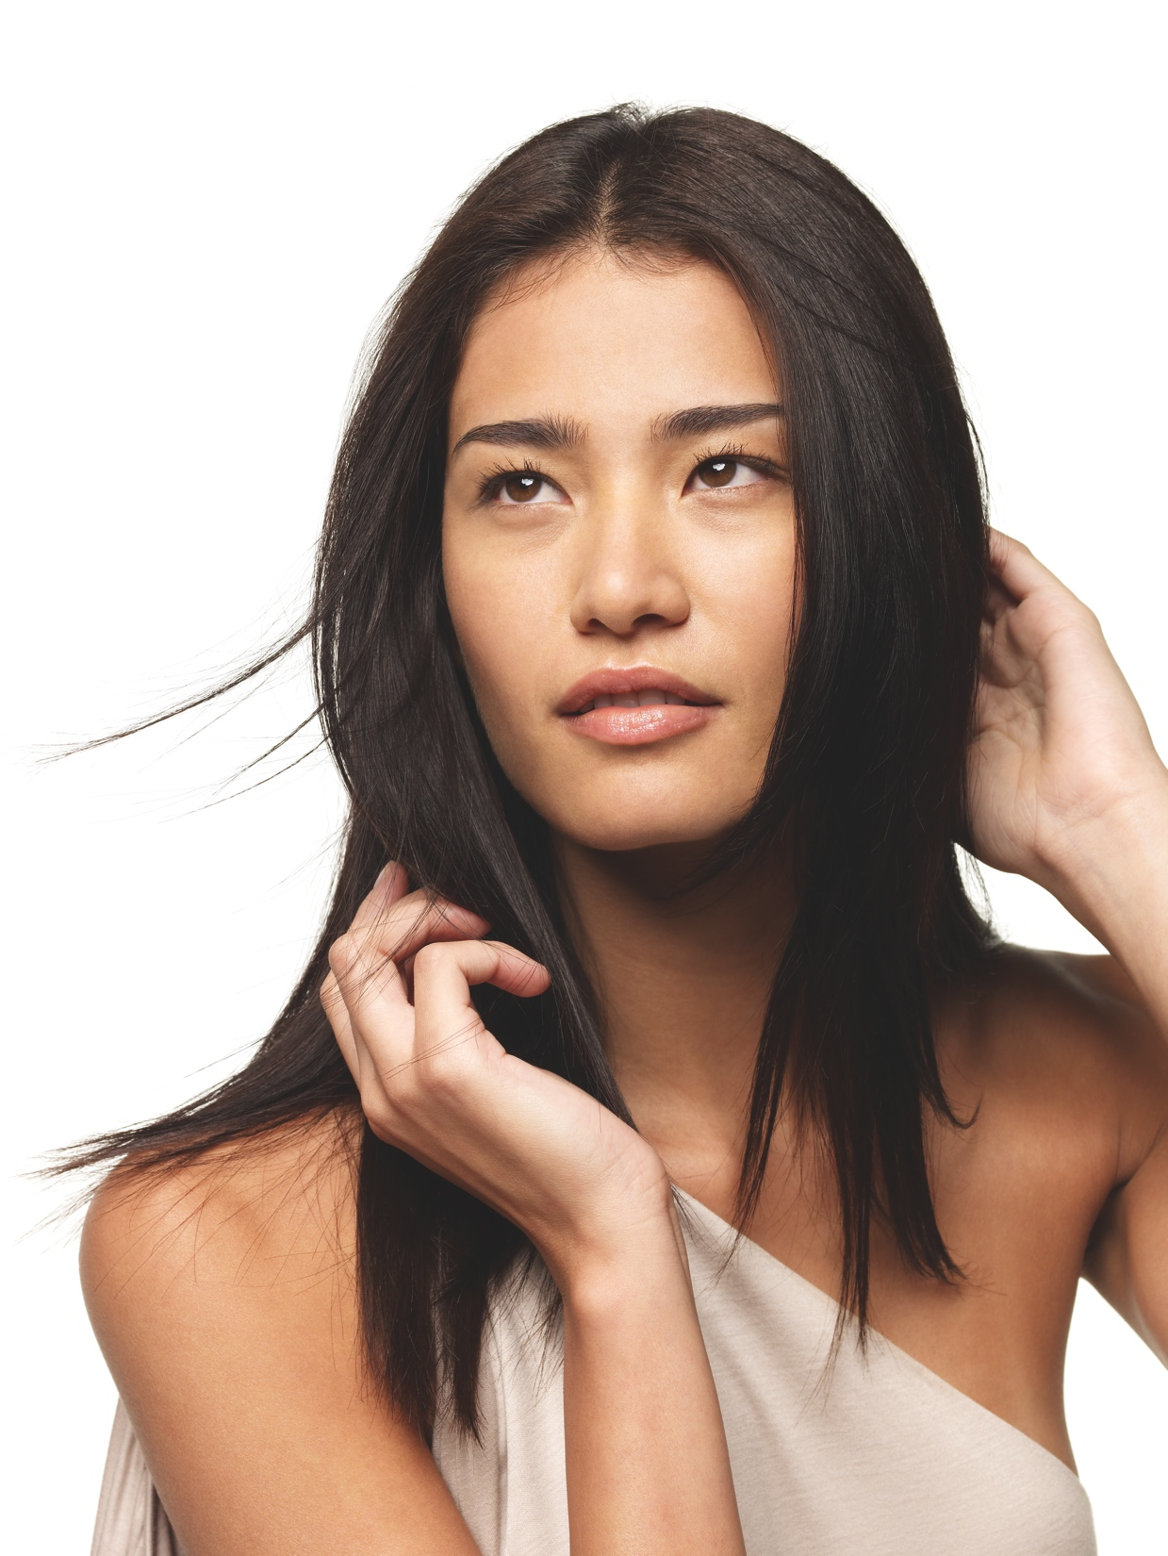
Turning Back Your Skin’s Clock
Even if you did not properly care for your skin in years past, there are many technologically advanced ingredients that help repair the visible signs ageing.

Slide 12
ageLOC Body Shaping Gel
For a more contoured, firmer, smoother you.
ageLOC Body Shaping Gel is formulated to work exclusively with patented Nu Skin Galvanic Spa instruments to bring ageLOC anti-ageing benefits to the body. For years, leading spas have used combinations of special treatment tools and formulations to minimise the appearance of cellulite. With ageLOC, Nu Skin takes it one step further. ageLOC Body Shaping Gel is an intensive spa quality treatment that minimises and smooths the appearance of fat and cellulite, improves the appearance of skin’s firmness, and helps improve the overall appearance of the skin.

Slide 13
Key Benefits
ageLOC targets the ultimate sources of ageing to preserve the look of youth and reduce the appearance of ageing.
Helps minimise and smooth the appearance of fat and cellulite for a slimmer, contoured appearance.
Evens out the appearance of dimpled areas.
Improves appearance of skin’s firmness for a more youthful look.
Strengthens the extracellular matrix (ECM) of the skin to help build and maintain healthy looking skin.
Formulated to help refresh and purify the skin, reducing the visible signs of ageing.
Helps improve overall appearance of skin.

Slide 14
Key Ingredients
ageLOC—proprietary Nu Skin technology that targets arSuperMarkers, the ultimate sources of ageing.
Laminaria Digitata—helps increase fat breakdown; has been shown to increase mitochondria respiration in human keratinocytes resulting in energy production; and has been shown to increase the synthesis of structural proteins.
Theobromine (Theobroma cacao (cocoa) extract)—shown to inhibit a certain enzyme in fat cells. Inhibition of this enzyme activates fat breakdown, leading to a more contoured, smoother appearance.

Slide 15
Key Benefits Supported

Slide 16
Key Benefits Supported
ageLOC targets the ultimate sources of ageing to preserve the look of youth and reduce the appearance of ageing.
Based on the discovery of arSuperMarkers, ageLOC science is utilised to help validate products that target the sources and signs of ageing. Through ageLOC science and research, our scientists have been able to identify ingredients that have a positive impact on arSuperMarkers, including Youth Gene Clusters. By combining ageLOC science, which targets the sources of ageing, with cutting-edge corrective anti-ageing ingredients, which reduce the visible signs of ageing, Nu Skin® products provide a preventative and corrective approach to maintaining and promoting youthful skin.

Slide 17
Key Benefits Supported
Helps minimise and smooth the appearance of fat and cellulite for a more contoured appearance.
Cellulite is a protrusion of fat into the dermis that is visible topically. With age, the skin’s structural proteins continue to be degraded and their production slows. ageLOC Body Shaping Gel is formulated with ingredients Theobroma Cacoa Extract and Laminaria Digitata Extract that increase fat breakdown and help to promote the production of structural proteins. These ingredients allow ageLOC Body Shaping Gel to help smooth the appearance of fat and cellulite, resulting in a more contoured, more youthful looking body.

Slide 18
Key Benefits Supported
Evens out the appearance of dimpled areas.
Topographically, cellulite results in a dimpled appearance, such as a mattress, orange peel, or cottage cheese effect due to the protrusion of fat into the dermis. With ingredients that target the breakdown of fat and promote the production of skin protein, ageLOC Body Shaping Gel can even out the dimpled appearance of cellulitic skin.

Slide 19
Key Benefits Supported
Improves appearance of skin's firmness for a more youthful look.
ageLOC Body Shaping Gel features Laminaria Digitata Extract, which has been shown to increase structural protein synthesis by aging fibroblasts. When the skin has adequate key structural proteins, it is firm and looks youthful.

Slide 20
Key Benefits Supported
Strengthens the extracellular matrix (ECM) of the skin to help build and maintain healthy looking skin.
As we age, our fibroblasts slow. Fibroblasts are responsible for production of skin’s structural proteins, so when fibroblasts slow, less of the skin’s structural proteins are produced. Laminaria Digitata extract has been shown in vitro to have positive effects on aging fibroblasts. These models also showed an increase in collagen synthesis equivalent to young fibroblasts when treated with Laminaria Digitata extract.

Slide 21
Key Benefits Supported
Formulated to help refresh and purify the skin, reducing the visible signs of ageing.
Laminaria Digitata extract has been shown to target mitochondria, increasing cellular respiration and resulting in energy production. With ample energy, cells are able to rid themselves of degraded components (impurities) which could contribute to cell damage and ageing. This energy production allows the cells to purify themselves and help promote youthfulness.

Slide 22
Key Benefits Supported
Helps improve overall appearance of skin.
Nu Skin clinical studies have shown the ability of technologies in ageLOC Body Shaping Gel in combination with direct (galvanic) currents to increase the overall appearance of the skin. ageLOC Body Shaping Gel is formulated with ingredients that have been shown to increase the breakdown of fat and increase the structural proteins within the skin, thus yielding overall improvements in the skin’s appearance.

Slide 23
ageLOC Body Shaping Gel Pairs with
Galvanic Spa Technology
The patented self-adjusting galvanic current of Nu Skin Galvanic Spa instruments works synergistically with proven ingredients in ageLOC Body Shaping Gel to facilitate transport of key ingredients. This exclusive treatment helps increase cellular energy to help refresh and purify, while reducing the visible signs of ageing.

Slide 24
Usage
Use three days per week on problem areas. Apply gel liberally to area to be treated and rinse hands. Use a Nu Skin Galvanic Spa instrument to gently massage area until treatment cycle is complete. Wipe away excess product with a damp cloth. Not for use on the face or delicate skin areas.
For best results, follow with ageLOC Dermatic Effects.
Refer to the owner’s manual for complete instructions on how to use and clean your Galvanic Spa instrument.
Notes:
Need to add various icons for all three Galvanic Devices

Slide 25
Target Audience
Primary Markets:
Women and men looking for a firmed, toned, younger-looking body.
ageLOC Galvanic Body Spa and Galvanic Spa customers.
Secondary Markets
Image conscious women, ages 25-65, who may occasionally visit day spas.
Women of any age with cellulite and other signs of ageing on the body.

Slide 26
Complementary Products
ageLOC® Galvanic Body Spa—features a proprietary ageLOC body conductive surface designed to increase delivery of ageLOC to your skin. Pulsating currents are optimised to maximise anti-ageing effects on the arms, abdomen, buttocks, and thighs. It also helps stimulate, purify, and refresh your skin to reduce the visible signs of ageing for a more contoured, smoother, firmer looking you.
ageLOC® Dermatic Effects® Body Contouring Lotion—scientifically formulated to bring ageLOC anti-ageing benefits to the body every day, ageLOC Dermatic Effects helps smooth the appearance of fat and cellulite and improve the appearance of skin firmness. This daily contouring moisturiser helps increase cellular turnover, returning skin to its natural radiance. It also hydrates and utilises leading edge optical technology to diffuse light instantly, helping skin look smoother while improving the appearance of the skin’s surface.
Liquid Body Lufra—revitalises and gives skin a luminous glow as you shower. Finely ground walnut shells buff out rough spots on elbows, backs of arms, knees, heels, and all over. With Liquid Body Lufra, you step out of the shower with smoother, softer skin.

Slide 27
Review
Key Benefits
ageLOC targets the ultimate sources of ageing to preserve the look of youth and reduce the appearance of ageing.
Helps minimise and smooth the appearance of fat and cellulite for a slimmer, contoured appearance.
Evens out the appearance of dimpled areas.
Improves appearance of skin’s firmness for a more youthful look.
Helps build and maintain skin’s robust structure, reinforcing structural proteins relevant to healthy looking skin.
Formulated to help refresh and purify the skin, reducing the visible signs of ageing.
Helps improve overall appearance of skin.

Slide 28
ageLOC® Body Shaping Gel

