Slide 1

EVERY DAY IS A CONFIDENT,
BEAUTIFUL SKIN DAY.

Slide 2

OUR DESIRE FOR INDIVIDUALITY
Around the world, people are challenging and changing stereotypes
and generalizations of aging, redefining ideals of youthfulness.
People are seeking to celebrate their individuality, focusing on becoming their personal best and expressing youth on their own terms.
People have the power to customize their lives to help them become their personal best.

Slide 3
OUR DESIRE FOR CUSTOMIZATION
Customization is 30% of what draws a customer to a brand.¹
46% of shoppers will buy more from a brand that customizes the shopping experience.²
Consumers are looking for custom-made solutions that fit their specific needs and are becoming more engaged in product creation.³
Sources
¹ “Predicting market success: new ways to measure customer loyalty,” Robert Passikoff, 2006
² Medallion Retail Research from Emarketer Study
³ “Five game-changing consumer trends,” Bank of Canada, 2013

Slide 4
SKIN CARE CUSTOMIZATION
Customized skin care is a $12.2 billion market.¹
22% of global skin care usage is driven by individualism with consumers seeking out products.³
Increasingly interested in products tailored to their individual needs, many consumers are willing to pay premium prices and wait up to a month to receive customized formulas.¹
CUSTOMIZED SKIN CARE IS EXPECTED TO GROW RAPIDLY OVER THE NEXT FIVE YEARS.²
Sources
¹ Canadian Research Firm, Sept 2014
² Medallion Retail Research from Emarketer Study
³ BDC Study 2014, pg 26

Slide 5

SKIN CARE CUSTOMIZATION
“Personalized skin care is a growing market as firms adopt technologies that enable them to customize products according to individual traits and susceptibilities. Consumers are responding in turn, eager for products that get to the root of their skin complaints and distinguish their regimens from their neighbors.”
PERSONALIZED SKIN CARE FUELED BY TECH ADVANCES, GROWING DEMAND—ROSE SHEET, OCT 8, 2014

Slide 6
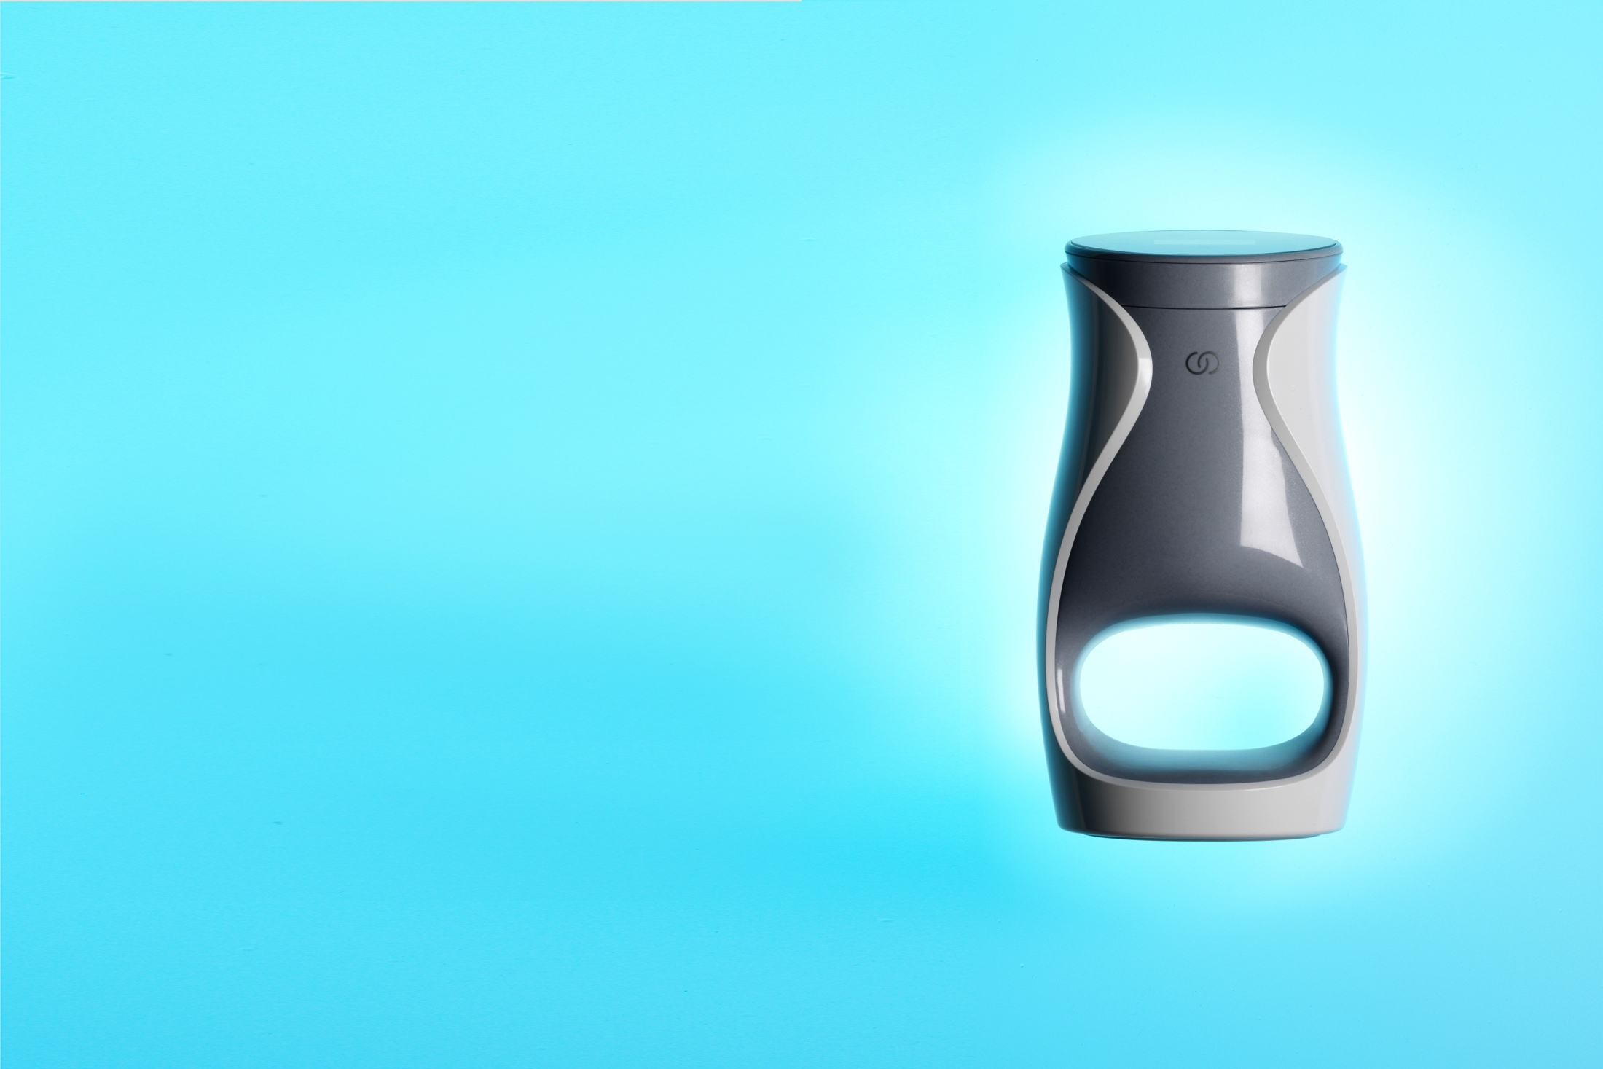
INTRODUCING
INTRODUCING
Imagine anti-aging skin care as individual as you are. Now it can be with state-of-the-art technology and breakthrough anti-aging formulations. Nu Skin has redefined skin care with ageLOC Me. This is anti-aging skin care like you’ve never seen, felt, or imagined.

Slide 7

INTRODUCING
Introducing ageLOC Me, an entirely new approach to anti-aging skin care. Featuring five powerful, cutting-edge products and one smart delivery device, ageLOC Me is customized for you, by you. With ageLOC Me, every day is a confident, beautiful skin day.

Slide 8

AGELOC ME SYSTEM FEATURES AND BENEFITS
ageLOC Me is an innovative and sophisticated
product system that features:
Customizable products
Smart device
Continued customization
Benefits
Features five powerful, cutting-edge products
Makes sticking to your skin care routine easy and fun
Customizes and simplifies your daily skin care routine
Makes your routine more convenient and hygienic
Provides a precise dose twice a day, every day
Features five customizable product delivery modes
Includes remaining dose alerts and the option to sign up for auto delivery to receive your refills
Allows for continued customization
Notes:
Features several product delivery options including semi-automatic, fully automatic, non-delivery demo, travel, and single use mode.

Slide 9

YOUR AGELOC ME EXPERIENCE
IS A SIMPLE FOUR-STEP JOURNEY
STEP 1:
Take Your First Step Toward Customization
STEP 2:
Tell Us About You
STEP 3:
Experience Your Customized Skin Care Regimen
STEP 4:
Keep It or Change It Up

Slide 10
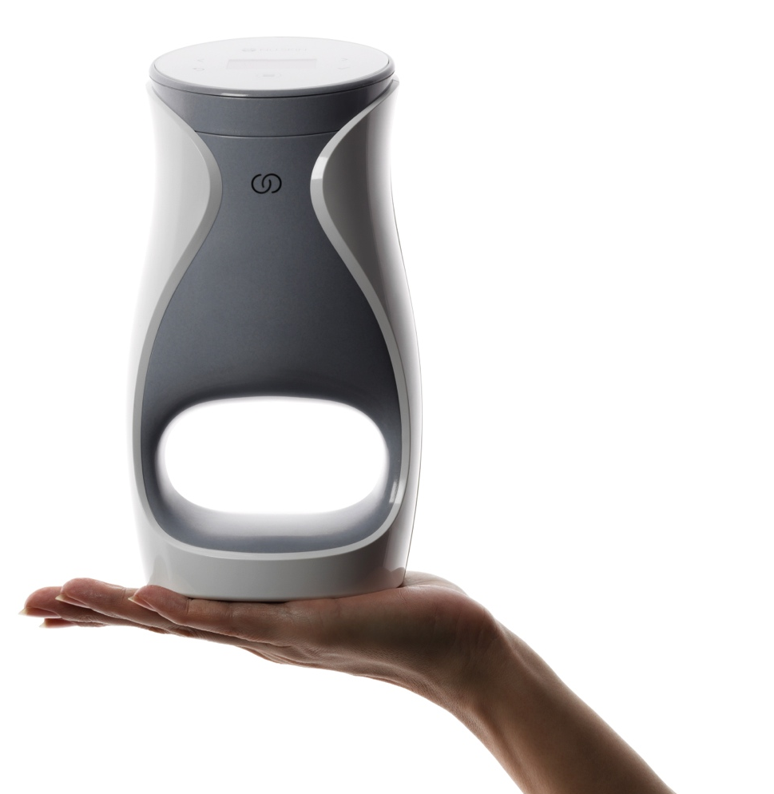
YOUR AGELOC ME EXPERIENCE—STEP 1
Take your first step toward customization.
Order your Starter Kit
Starter Kit contains your Reference Set
Reference Set
  Gives you immediate access to products and anti-aging benefits
  Is your reference for your ageLOC Me skin assessment to further customize your products
  Helps you get comfortable using your ageLOC Me device
Notes:
Order your Starter Kit online or from a distributor to start using ageLOC Me right away.
The Starter Kit contains your Calibration Set, a set of five products specifically formulated to deliver comprehensive anti-aging benefits to most users.
With the Calibration Set, you have immediate access to the products so you can experience how they feel and how they benefit your skin.
The Calibration Set will help you get comfortable using your ageLOC Me, and you should use it as a reference when you take your ageLOC Me skin assessment to further customize your products.

Slide 11
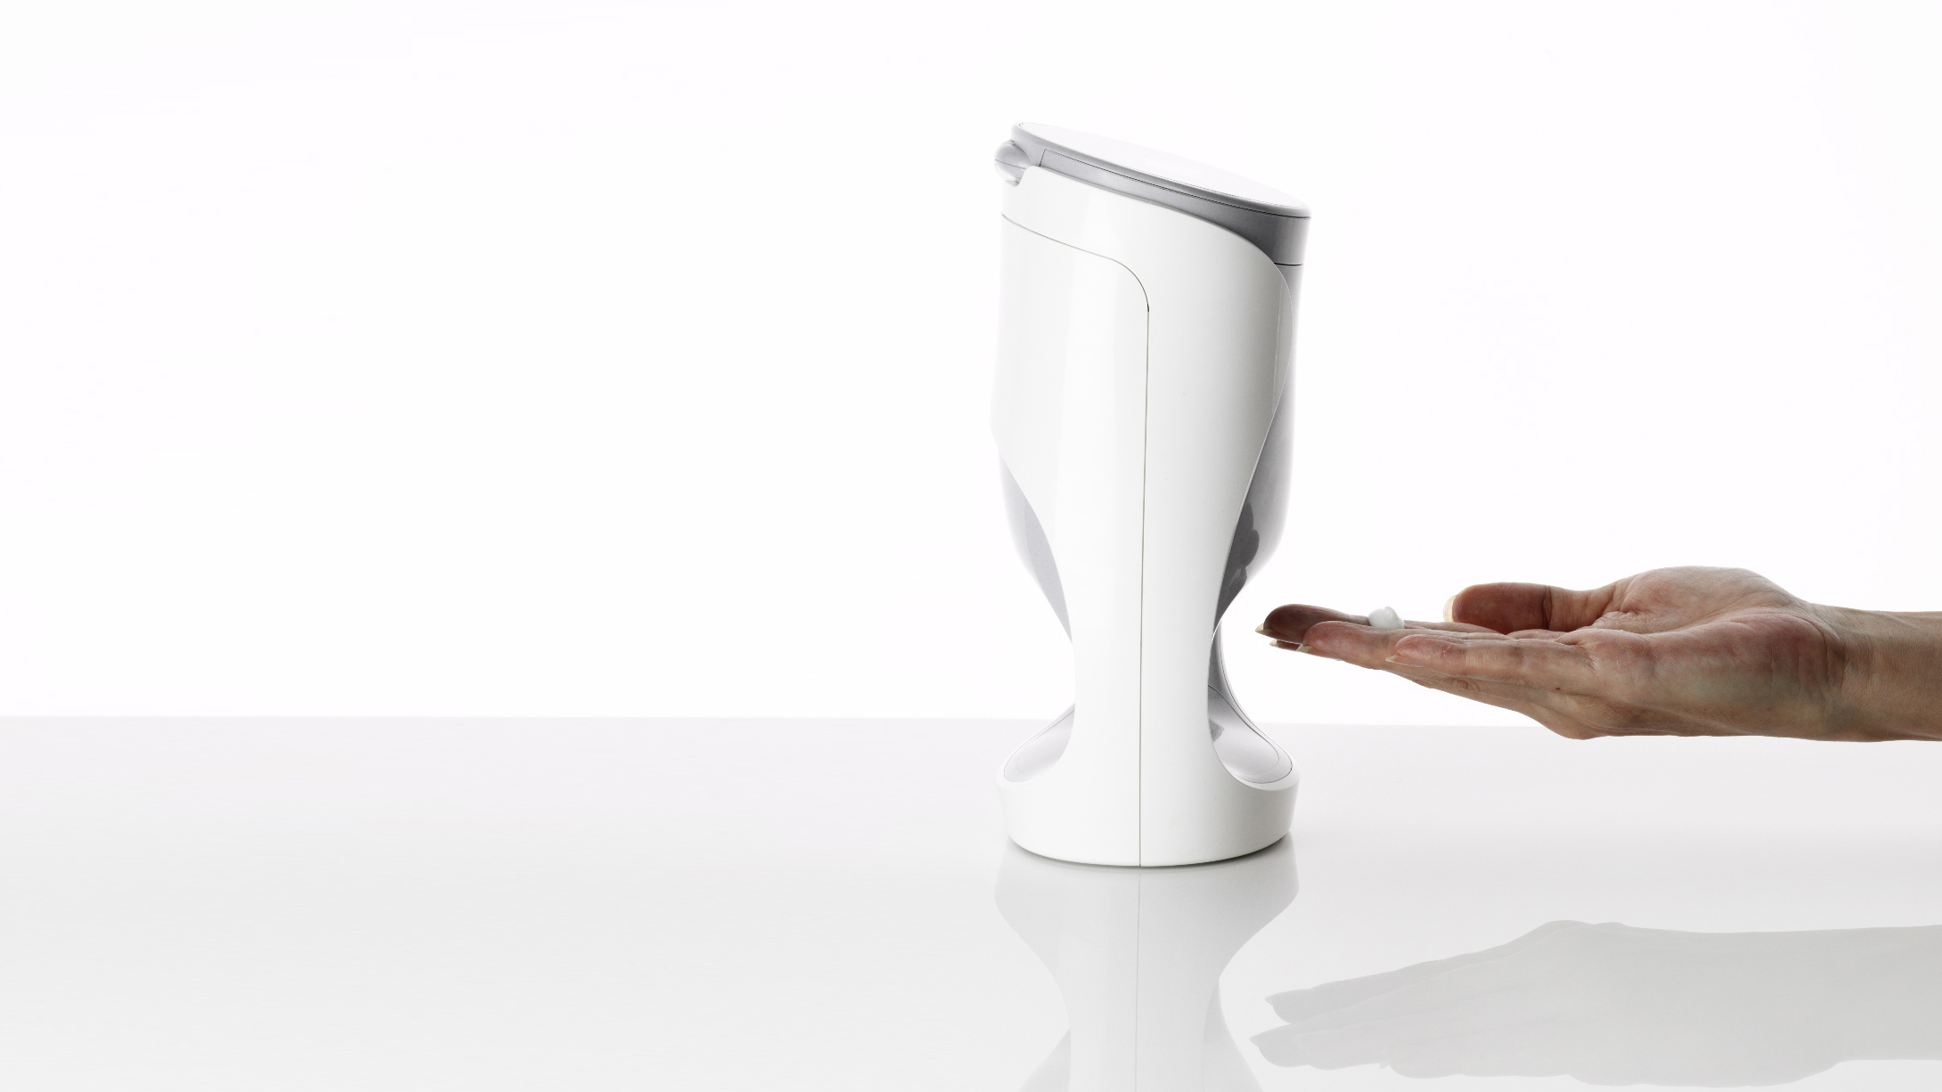
AGELOC ME STARTER KIT CONTENTS
ageLOC Me Device
Five-Cartridge Product Reference Set
ageLOC Me User Manual
Travel Containers
Four Premium Alkaline AA batteries
Serum Cartridge Holder
ageLOC Me Connector
Notes:
When you first purchase your ageLOC Me system, you will receive your Starter Kit, which includes:
ageLOC Me delivery system
ageLOC Me Getting Started Guide
ageLOC Me User Manual
Travel container
Four AA batteries
Fragrance sample
Serum Cartridge Holder
ageLOC Me Connector
Five-Cartridge Product Calibration Set

Slide 12

YOUR AGELOC ME EXPERIENCE—STEP 2
Tell us about you, your skin, and your preferences with the ageLOC Me skin assessment.
Helps you identify your skin care needs and preferences through a series of questions
Lets you choose your preferred moisturizer weight
Lets you choose to include fragrance
in your moisturizers
Lets you select a day moisturizer with or without sunscreen ingredients
Helps you dial in targeted benefits with
the serums
Gives you your personal skin care code
Allows you to order your customized set
Notes:
Helps you determine your skin care needs through a series of questions concerning your environment, individual skin attributes, personal aging concerns, and product preferences.
You can choose to include fragrance in your moisturizers. You can also include or remove SPF from your Day Moisturizer.
You can dial in targeted benefits with the serums to meet your individual needs.
At the end of the assessment, you’ll receive your skin care code, which you use to order your customized set.

Slide 13
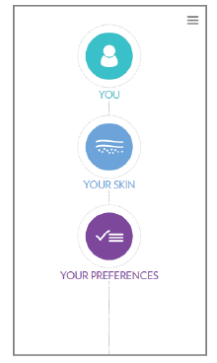
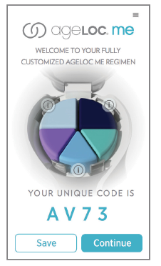
AGELOC ME SKIN ASSESSMENT
ageLOC Me eliminates the guesswork.
Use the Reference Set for 15 days, then take the skin assessment
The skin assessment determines your customized set of five products
You can access the skin assessment by downloading the
ageLOC Me App, available on iTunes and Google play
store, or by visiting www.nuskin.com.
Notes:
ageLOC Me eliminates the guesswork, making skin care product selection much simpler and more precise.
After you use the initial Calibration Set for fifteen days, take the detailed skin assessment where we address specifics: age, climate, skin type, ethnicity, and aging concerns. We also assess your product preferences, such as gel or lotion and fragrance or fragrance free.
Through its sophisticated algorithm, the assessment determines a new set of five customized products, which you can order at the end of the assessment.

Slide 14

YOUR AGELOC ME EXPERIENCE—STEP 3
Experience your customized skin care regimen.
Order your customized set with your personal skin care code. You told us about you, your skin, and your preferences and, combined with our expertise in anti-aging science innovation, we created a regimen that’s just for you.
Your customized set contains three serums, a day moisturizer, and a night moisturizer
ageLOC Me serums and moisturizers are Nu Skin’s most sophisticated anti-aging skin care formulations to date.

Slide 15
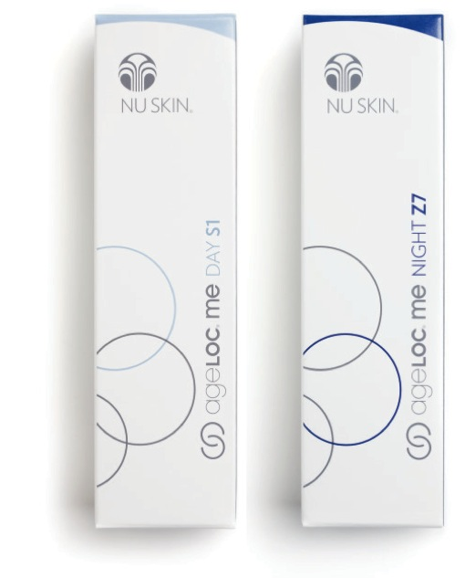
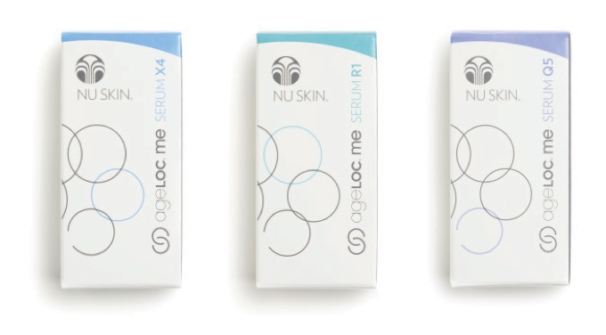
AGELOC ME PRODUCTS
Inspired by more than 30 years of anti-aging science
Represent Nu Skin’s most advanced anti-aging formulas to date
Customized based on your needs and preferences
Feature ageLOC technology to target the sources of aging and preserve the look of youth

Slide 16
AGELOC ME SERUM BENEFITS
Reduce the appearance of fine lines and wrinkles
Smooth the appearance of moderate to deep lines
Increase skin brightness and radiance
Decrease discoloration, age spots, and uneven skin tone
Contour the skin
Firm the appearance of skin around the chin, jawline,
eyes, and neck
Smooth rough skin texture
Reduce pore size

Slide 17
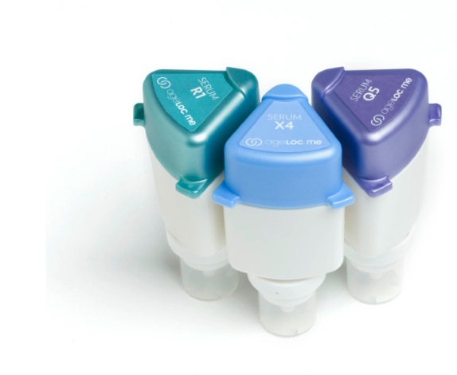
AGELOC ME SERUMS
Cellular Turnover
  Specialized ageLOC Me Serum helps improve cellular turnover to refine texture, reduce the appearance of pores, and reveal smoother, softer skin—for a noticeably younger looking you.
Pigmentation
  Specialized ageLOC Me Serum helps prevent the visible signs of hyperpigmentation and age spots to reveal more even, radiant skin—for a noticeably younger looking you.
Lines/Wrinkles, Firmness
  Specialized ageLOC Me Serum helps improve the visible signs of lines, wrinkles, and sagging—for a noticeably younger looking you.

Slide 18
AGELOC ME MOISTURIZER BENEFITS
Provide hydration to strengthen and maintain the skin’s natural moisture barrier
Day Moisturizer provides optional broad spectrum protection from UVA and UVB radiation with SPF 20/25
Night Moisturizer calms, soothes, and rejuvenates skin during its natural nighttime recovery process
Formula combinations are suitable for different skin types, including dry, normal, combination, and oily skin.
Offer different options for texture and overall feel based on climate, skin type, and personal preference
Customizable elements include fragrance/non-fragrance and SPF/non-SPF

Slide 19
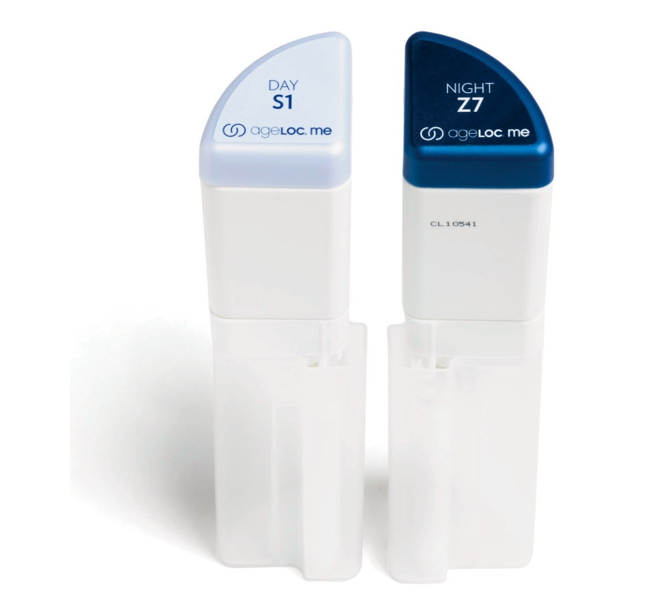
DAY AND NIGHT MOISTURIZERS
Night Moisturizer
Day Moisturizer
Gel-Cream
Ultra-Light Lotion
Light Lotion SPF 25
Medium Lotion SPF 25
Medium Cream
Inorganic Medium Cream SPF 20
Rich Cream SPF 25
Gel-Cream
Ultra-Light Lotion
Medium Cream
Intense Cream

Slide 20
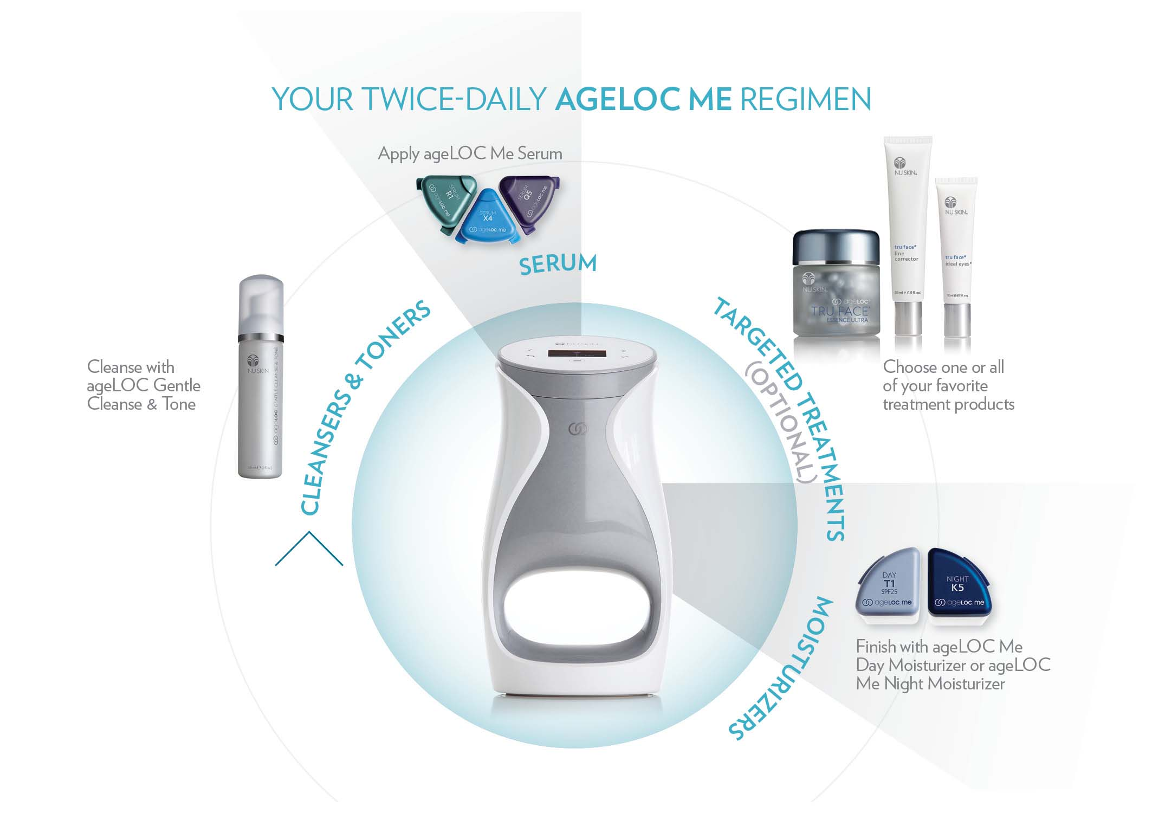
Products compatible with ageLOC® Me and suggested uses

Slide 21
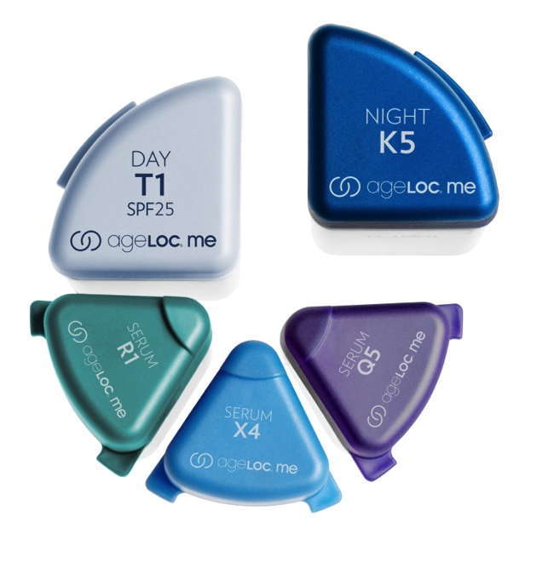
YOUR AGELOC ME EXPERIENCE—STEP 4
Keep it or change it up.
Retake the ageLOC Me skin assessment as your preferences or skin concerns change. You may find just the right combination for spring and summer, and then want to refine for fall and winter. There’s no limit to how many times you can take the assessment.

Slide 22
APPENDIX

Slide 23

AGELOC ME USAGE TIPS
To trigger ageLOC Me to deliver product, place hand in archway
Use buttons on lid to select preferred delivery mode
  Single delivery of one product only:
  serum or moisturizer
  Multiple day or night regimen delivery
  within the same day
  Remaining doses tracker
Use products twice daily for 30 days
The product sets contain a 30-day supply, making them an easy addition to ADR

Slide 24
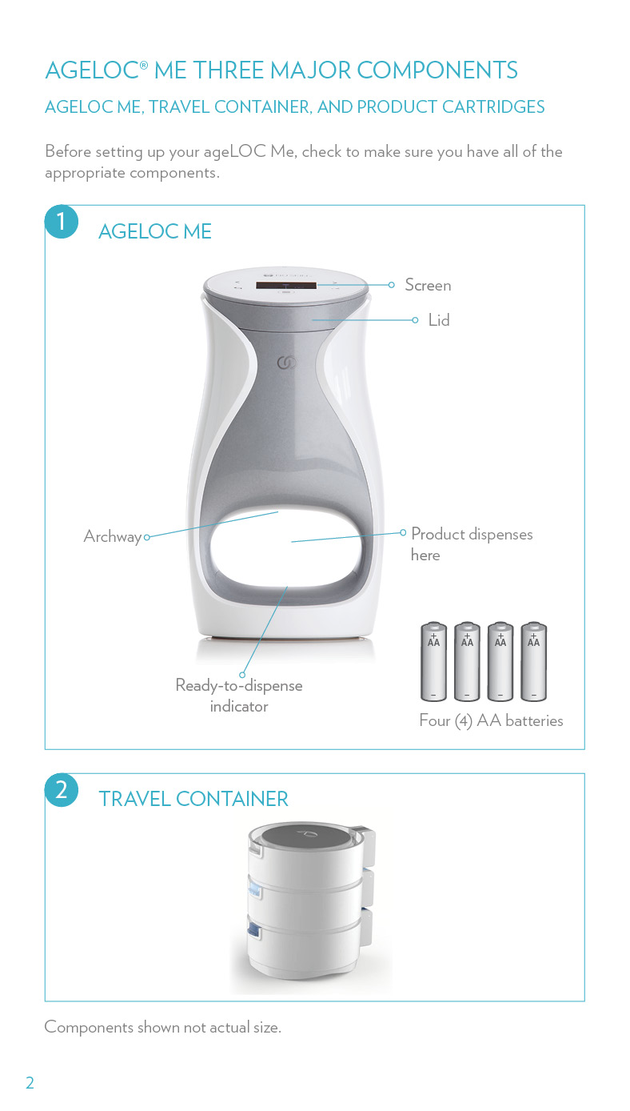
AGELOC ME COMPONENTS

Slide 25
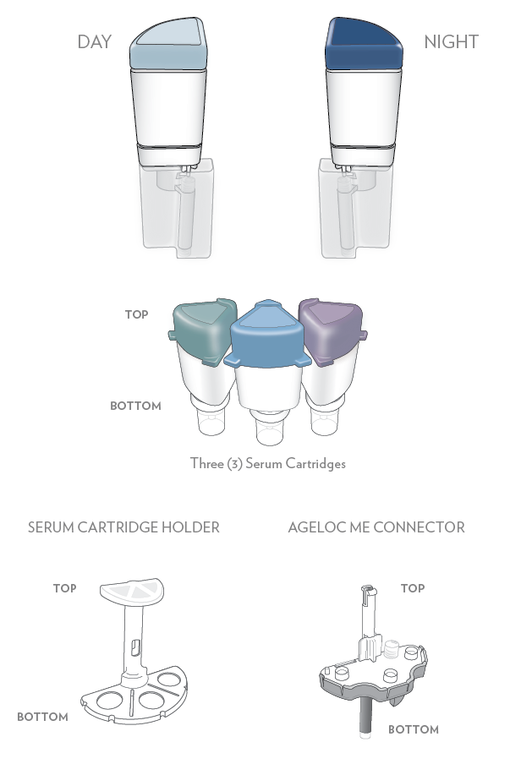
AGELOC ME CARTRIDGE SET

Slide 26
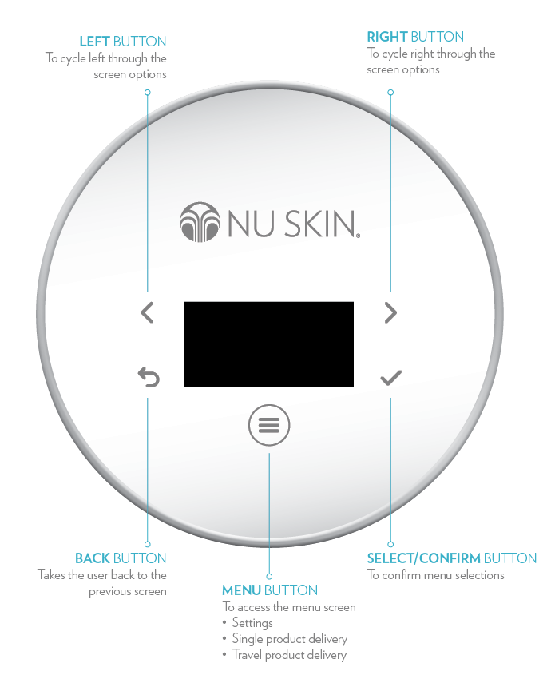
AGELOC ME BUTTON SYMBOLS

Slide 27
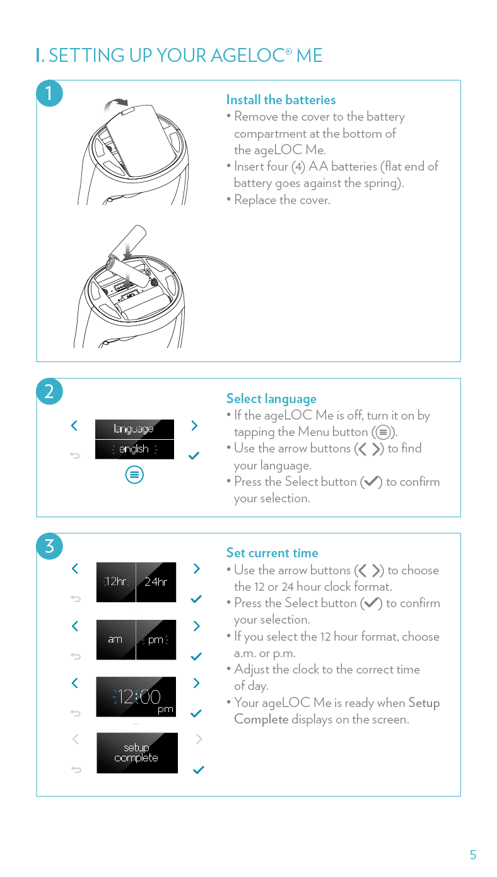
INSTALLING THE BATTERIES

Slide 28
SELECTING LANGUAGE AND SETTING TIME
Notes:
Automatic Mode—device will deliver product automatically when you put your hand in the archway. Your ageLOC Me is set to automatic mode by default.
Semi-Automatic—when you place your hand in the archway, device will ask if you are ready for it to deliver product. You will then need to select Yes or No.
No Hand Detection—device will not detect your hand when you place it in the archway. You will need to press the Ready button for ageLOC Me to deliver product.
Single Dose—device will deliver a single dose of your ageLOC Me Serum and Day or Night Moisturizer if needed. This option is ideal for demonstrations.

Slide 29
MODE AND DELIVERY OPTIONS
Modes
Automatic Mode—device detects hand; automatically delivers product
Semi-Automatic—device detects hand; asks if you are ready for product
Delivery Options
Full Regimen—device delivers precise doses of your serum and moisturizer, morning and night
Single Dose—you can choose to have the device deliver a single dose of either serum or moisturizer

Slide 30
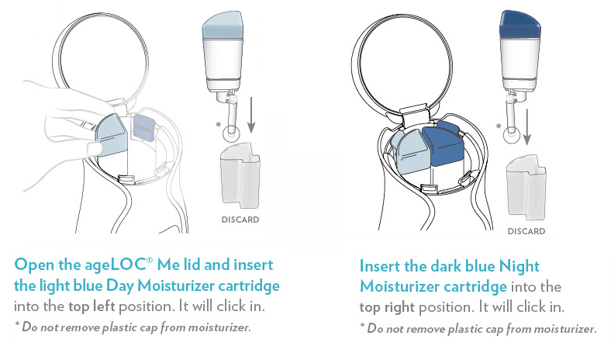
ASSEMBLING YOUR CARTRIDGES—
MOISTURIZERS
Product cartridges include a Day Moisturizer, a Night Moisturizer, and three Serums.

Slide 31
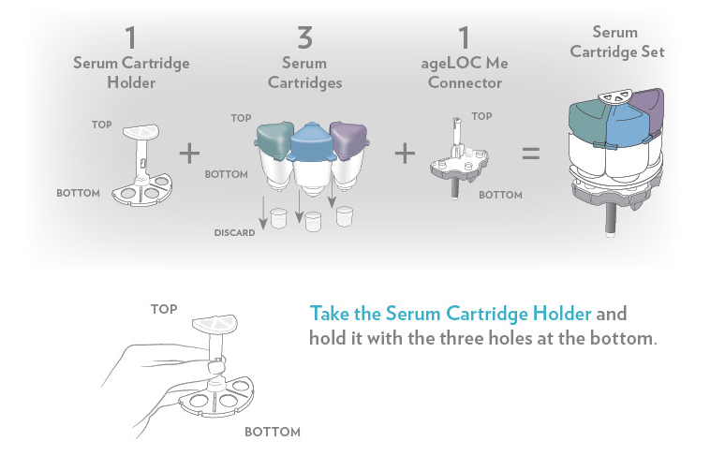
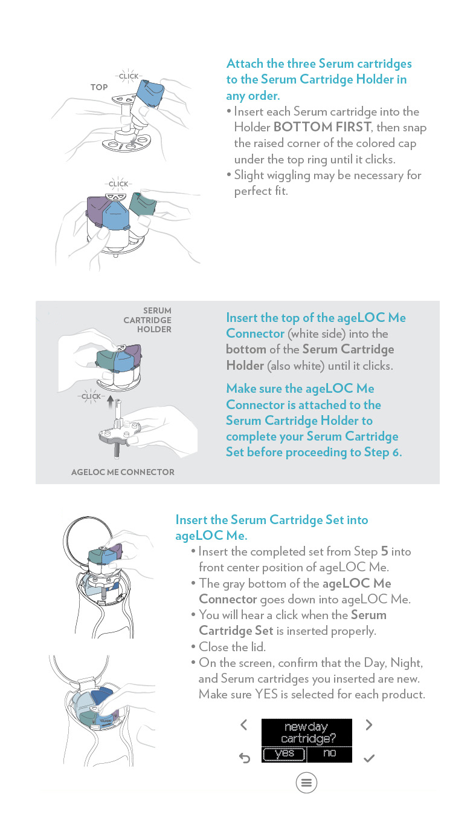
ASSEMBLING YOUR CARTRIDGES—SERUMS

Slide 32
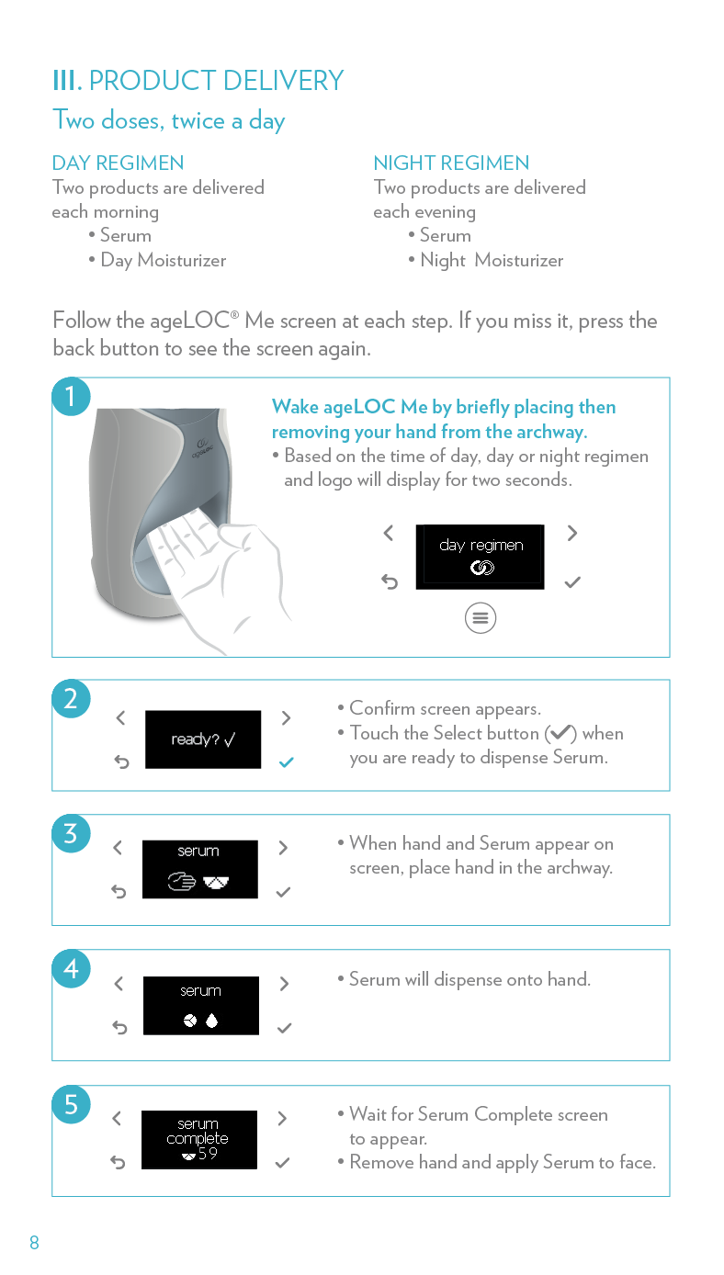
PRODUCT DELIVERY

Slide 33
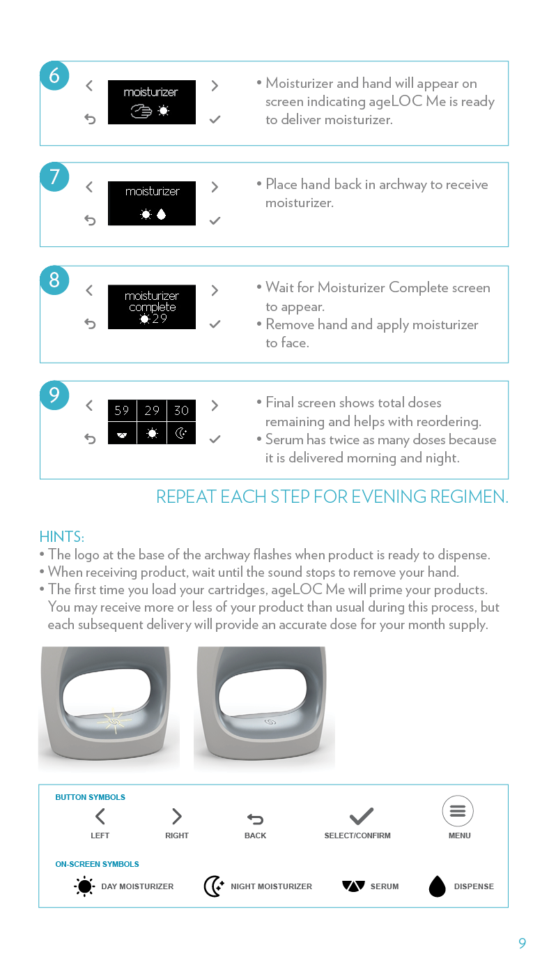
PRODUCT DELIVERY

Slide 34
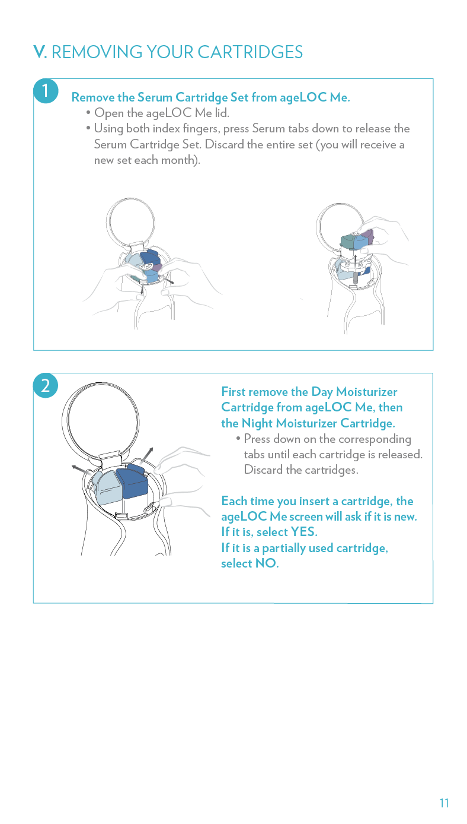
REMOVING YOUR CARTRIDGES
Notes:
ageLOC Me also comes with a convenient travel container.
The container has three separate dishes.
One for Serum
One for Day Moisturizer
One for Night Moisturizer
Each dish of the Travel Container flips open.

Slide 35
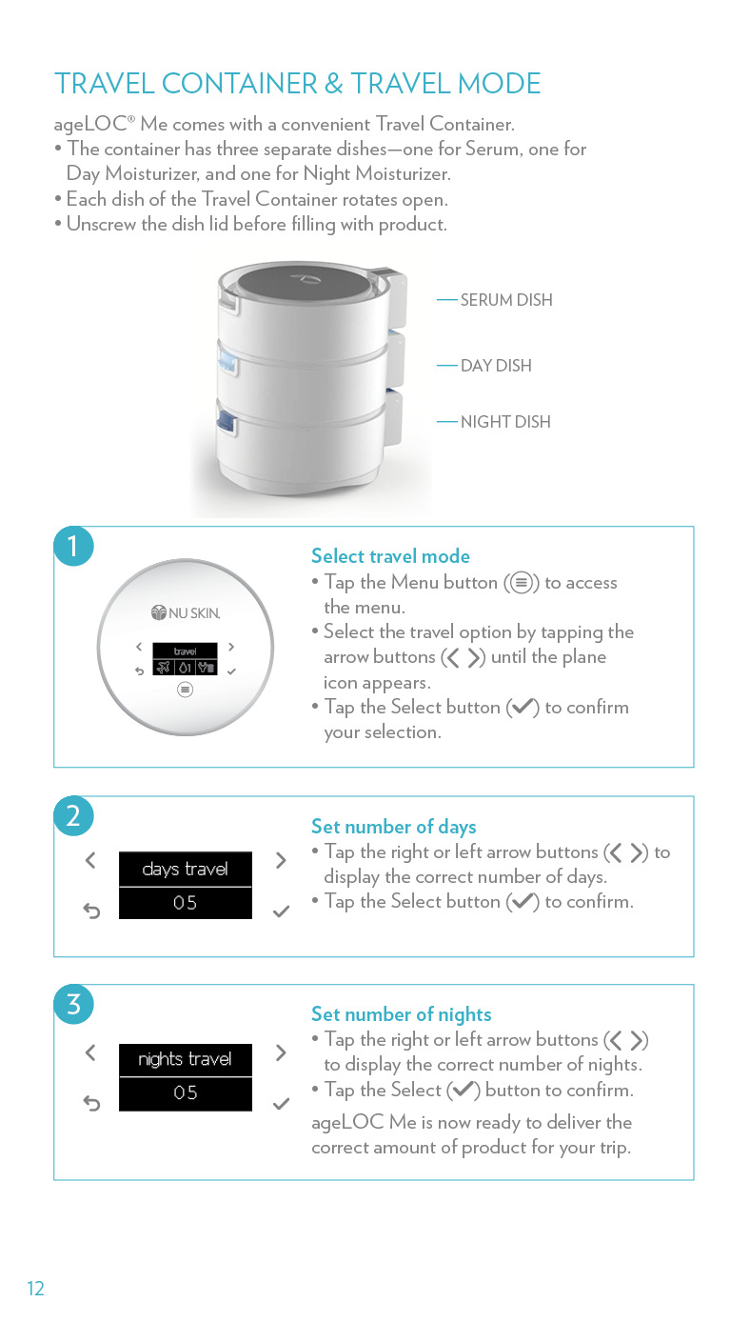
TRAVEL CONTAINER AND TRAVEL MODE
Need to travel? The smart device features a convenient travel mode and travel container so you never have to go without.
The travel container has three separate dishes:
    One for Serum
    One for Day Moisturizer
    One for Night Moisturizer
Each dish holds up to seven days worth of product
Each dish of the travel container flips open

Slide 36
TRAVEL CONTAINER AND TRAVEL MODE

Slide 37
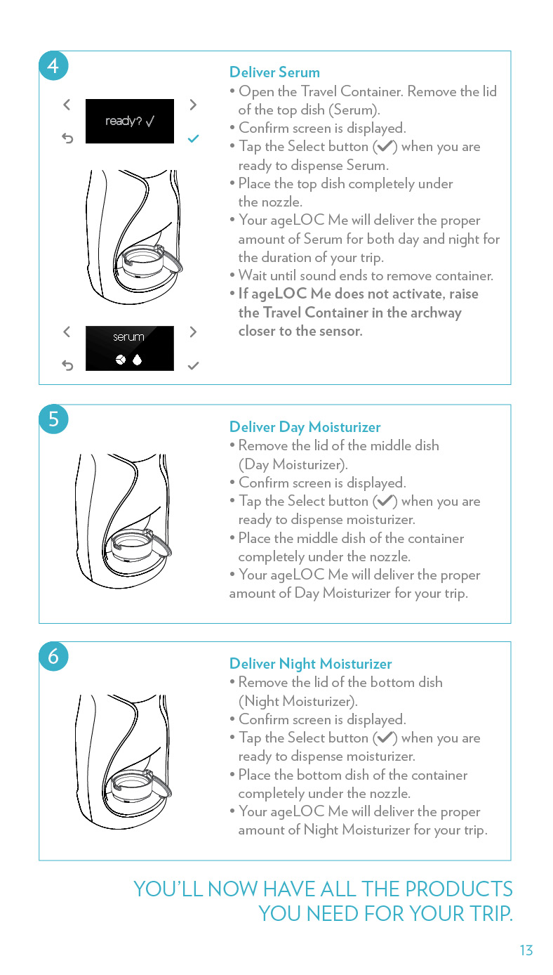
TRAVEL CONTAINER AND TRAVEL MODE

Slide 38
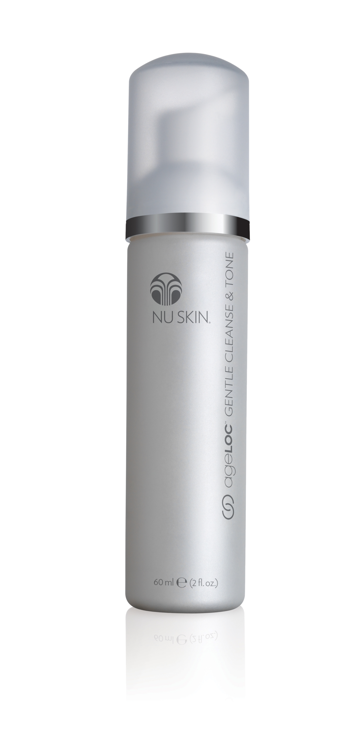
COMPLEMENTARY PRODUCTS
AGELOC GENTLE CLEANSE & TONE
Maintains skin’s natural healthy pH and delivers an infusion of ageLOC to the skin, targeting the sources of aging while leaving skin feeling refreshed and youthful.
TRU FACE IDEALEYES
Designed specifically for
the delicate eye area to reduce the appearance of bags and increase skin radiance and smoothness.
TRU FACE LINE CORRECTOR
Helps to soften the appearance of lines around your mouth, eyes, and forehead.

Slide 39
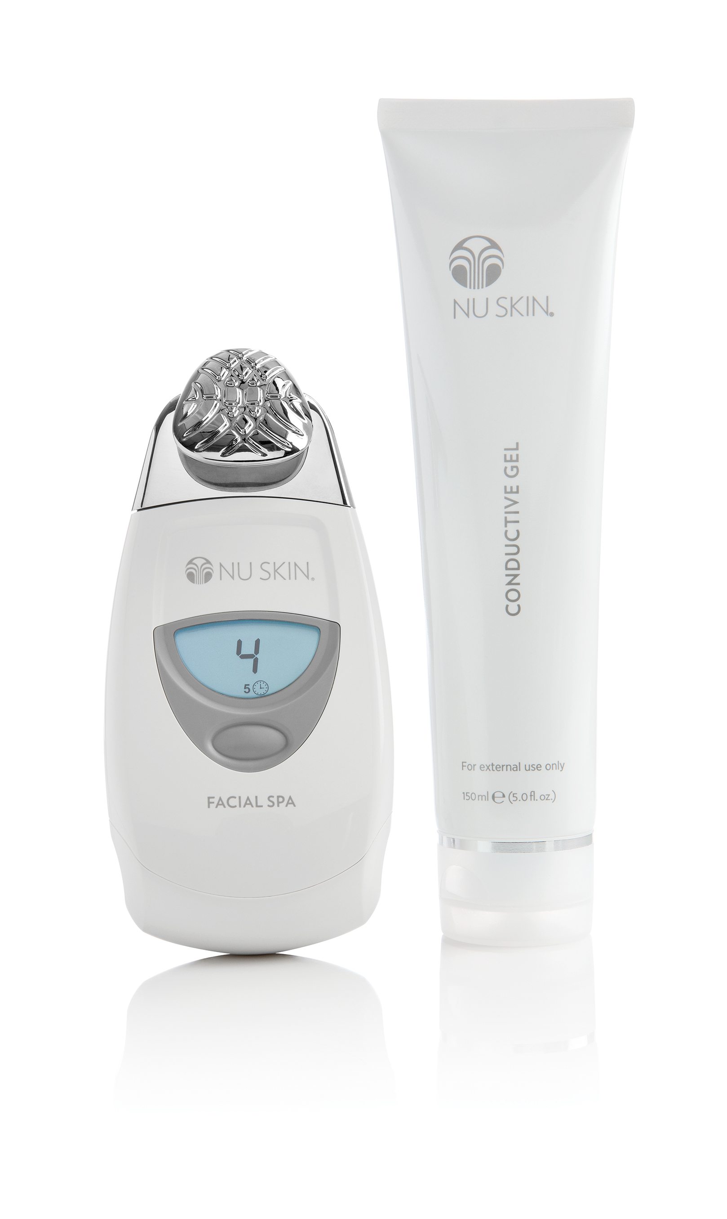
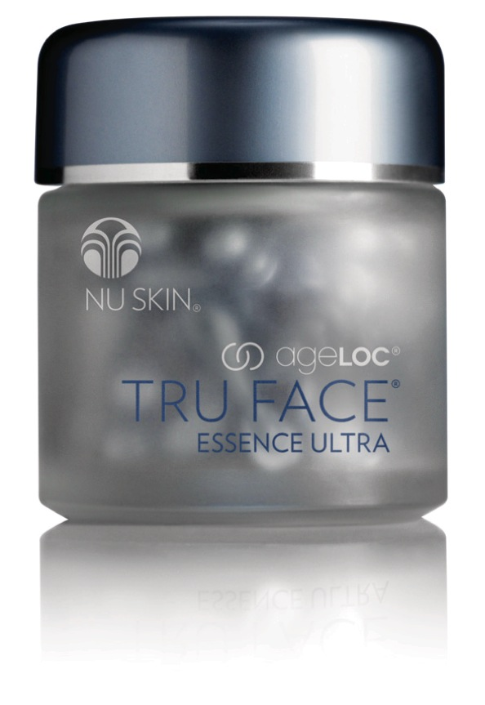
COMPLEMENTARY PRODUCTS
AGELOC TRU FACE ESSENCE ULTRA
Helps provide extra contouring and firming around the eyes, neck, chin, and jawline.
NU SKIN FACIAL SPA WITH CONDUCTIVE GEL
Features microcurrent technology to stimulate and tone the skin resulting in an improved appearance.

Slide 40
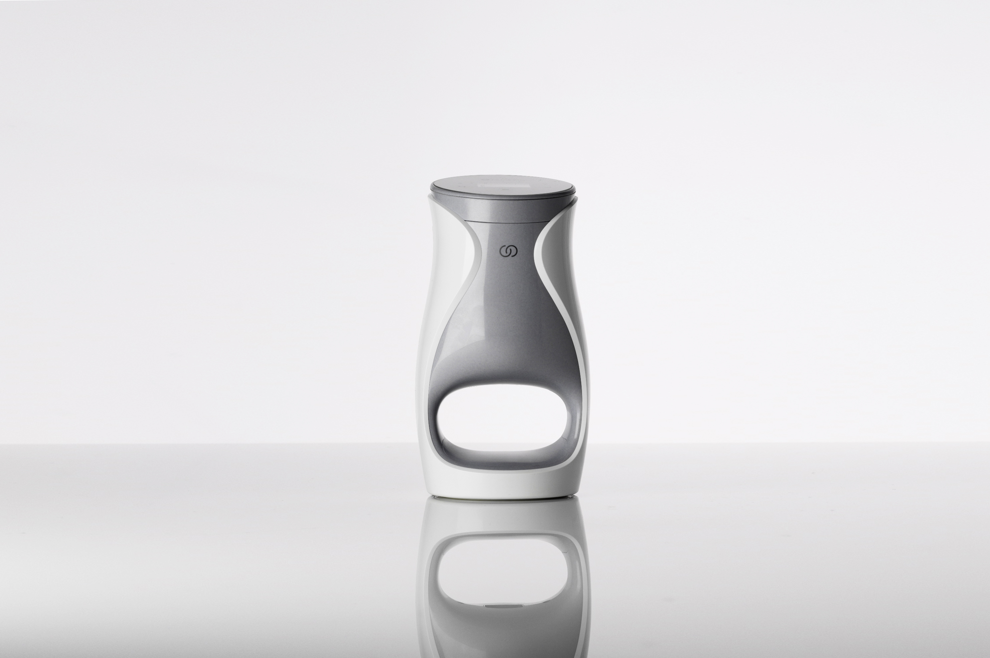
1 Smart device
5 Powerful products
1 Skin assessment
1 Personal skin care code
Continued customization

