Slide 1
Epoch Lavender Essential Oil

Slide 2
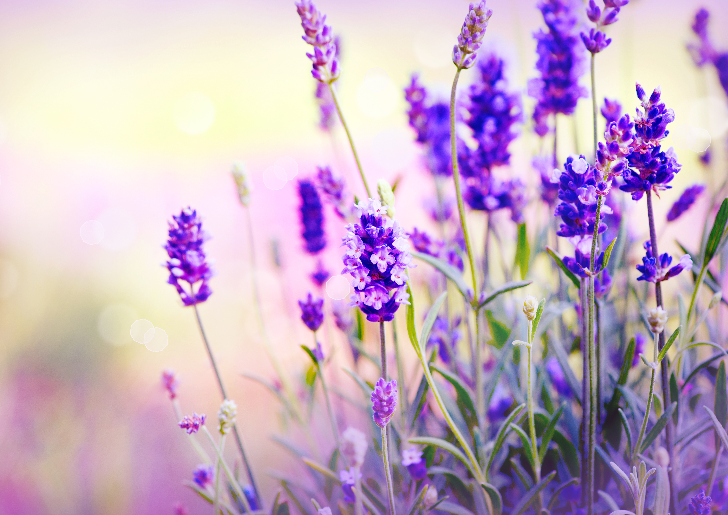
Lavender
Lavender has a floral, herbaceous, earthy aromatic profile.
Notes:
Lavender has a floral, herbaceous, earthy aromatic profile. A scientific name for lavender is Lavandula angustifolia.

Slide 3
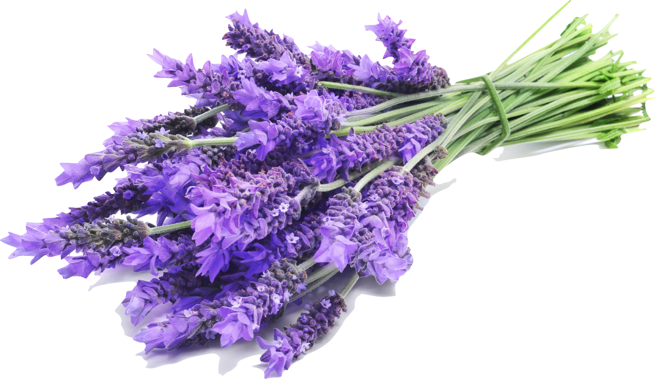
Ethnobotanical history
Many cultures used lavender as a relaxing form of aromatherapy.
For centuries, people have used lavender as a basic ingredient for many fragrances.
Romans used lavender for its cleansing and healthful properties.
Notes:
Many cultures used lavender as a relaxing form of aromatherapy. For centuries, people have used lavender as a basic ingredient for many fragrances. Romans used lavender for its cleansing and healthful properties.

Slide 4
Usage
Diffuse with an Epoch diffuser
Apply to the bottom of your feet
Apply to your wrists as a fragrance
Apply on your back when restless
Use when massaging your scalp
Use a few drops in a warm bath
Rub oil on your pillow at night to calm and soothe
Notes:
Today, Lavender still has many uses. When mixed with Epoch Topical Blending Oil it can be applied to the bottom of your feet, your wrists as a fragrance, on your back when restless, and used when massaging your scalp. Epoch Lavender is perfect to diffuse into the air with an Epoch diffuser. You can also put a few drops in a warm bath or rub this oil on your pillow at night to calm and soothe.

Slide 5
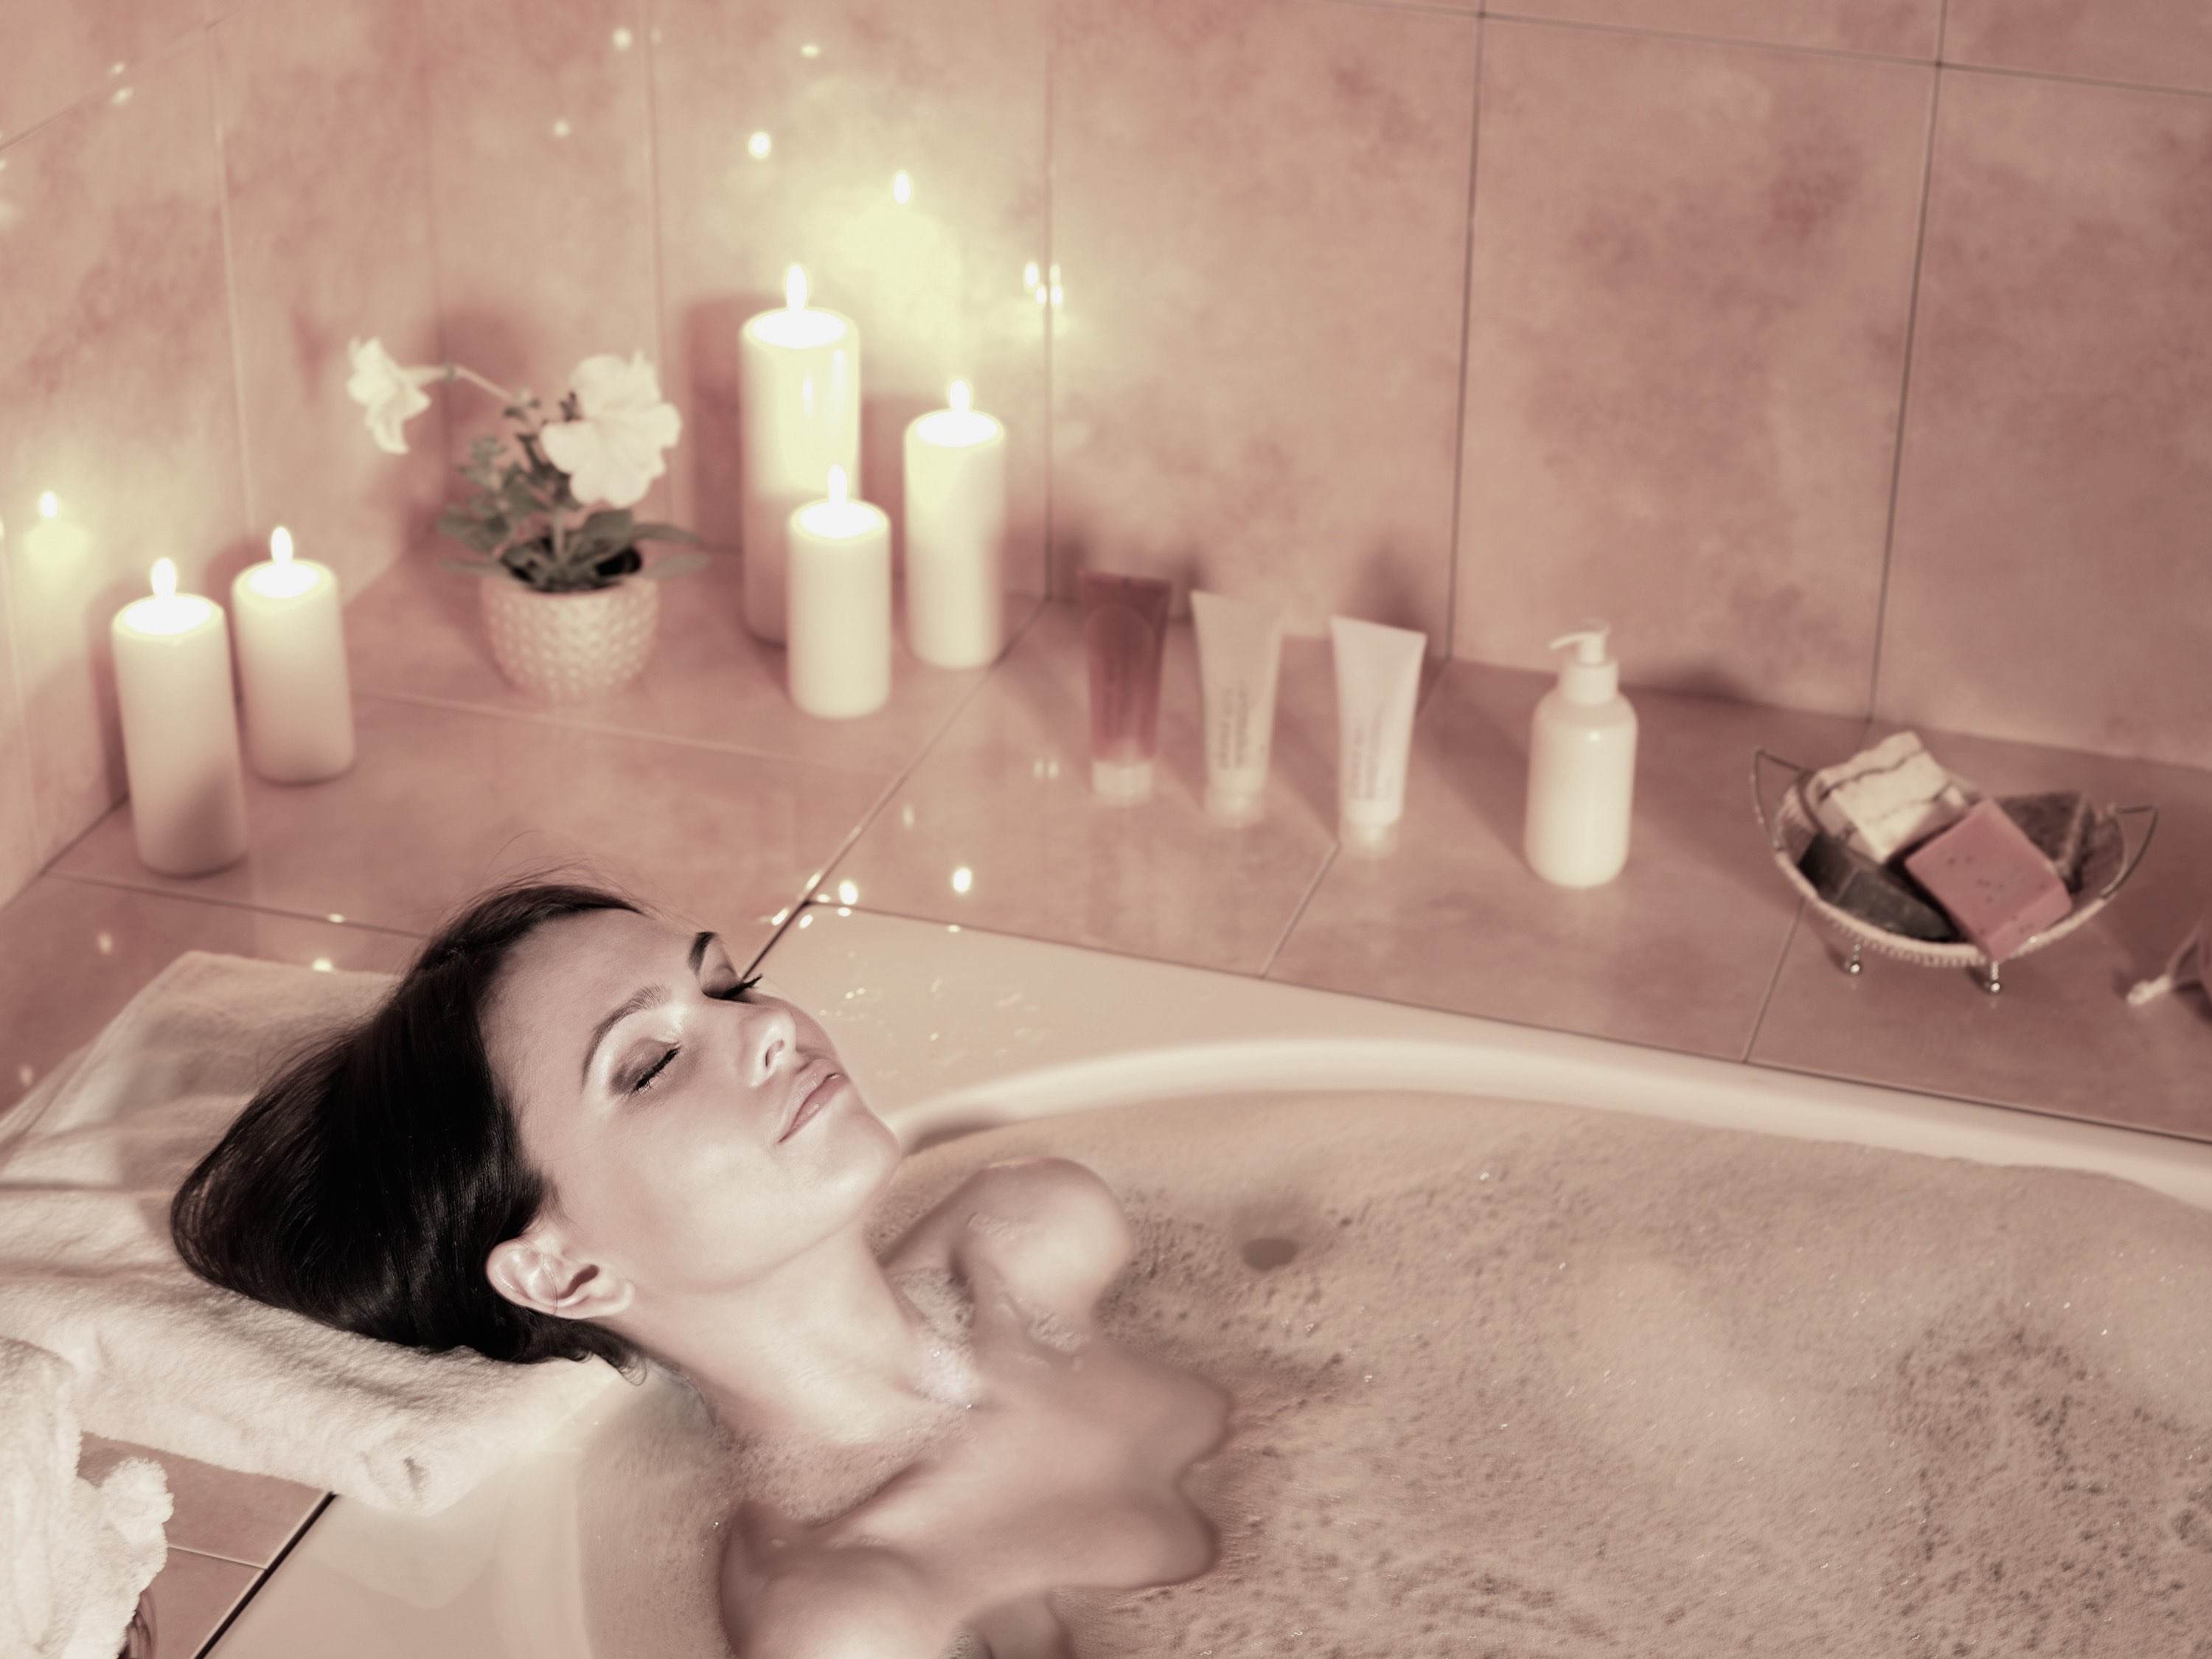
EPOCH Lavender
Tranquility | Peace | Relaxing | Calming
Notes:
The natural, floral aroma of Epoch Lavender essential oil provides a sense of tranquility and peace. Enjoy a relaxing end to even the busiest day with the calming benefits of Epoch Lavender.

