Slide 1
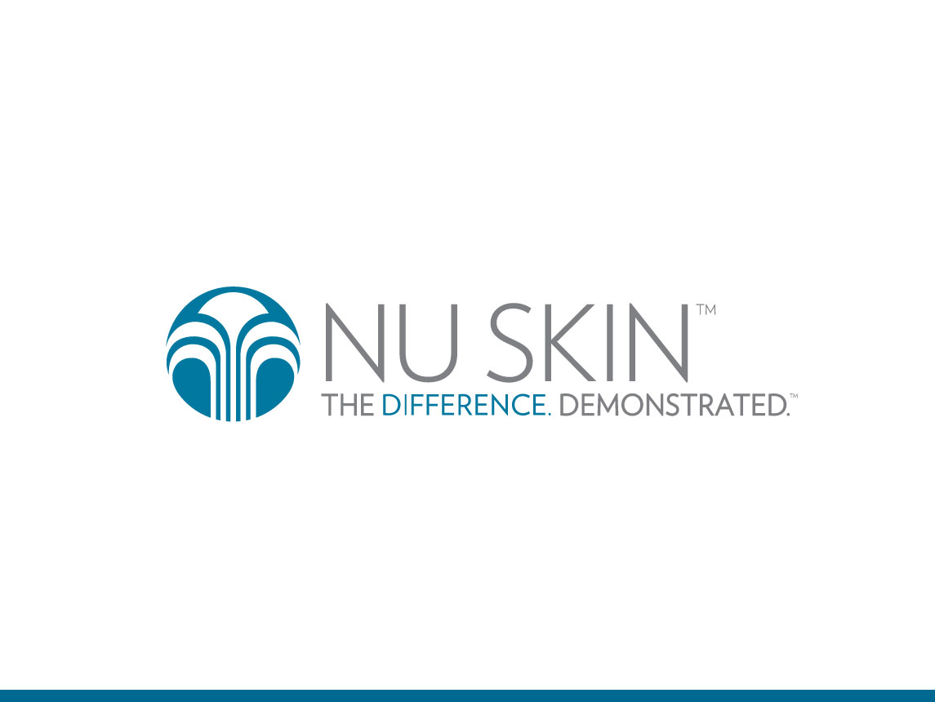
Notes:
Welcome to the ageLOC Tru Face Essence Ultra product training. The speakers for this presentation are Doctor Helen Knaggs, and Nu Skin Scientist Dale Kern.

Slide 2
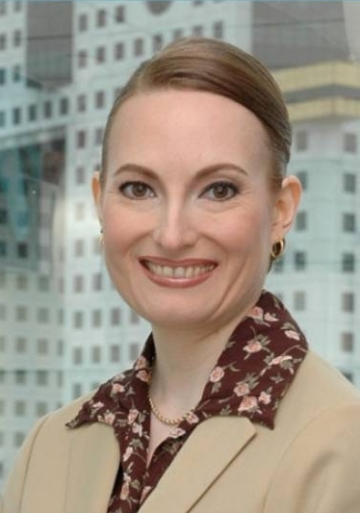
HELEN KNAGGS, PH.D
VICE PRESIDENT, GLOBAL RESEARCH AND DEVELOPMENT, NUSKIN
Notes:
Dr. Knaggs is the Vice President of Nu Skin Global Research and Development. She earned Bachelors Degrees in Biochemistry and Pharmacology, and a Doctorate Degree from the Department of Biochemistry and Molecular Biology at the University of Leeds England. She has numerous publications from her research including peer reviewed papers, posters and oral presentations.

Slide 3
DALE KERN
SENIOR SCIENTIST, GLOBAL RESEARCH AND DEVELOPMENT, NUSKIN
Notes:
Dale Kern brings over 30 years of technical experience to his role as Senior Scientist for Nu Skin. Dale earned a Master’s of Science Degree in Immunology from Wayne State University in Detroit, Michigan and has accumulated many hours of post-Masters coursework in physical biochemistry. He has consulted on numerous industrial, academic and regulatory projects and holds four International patents with many more in process.

Slide 4
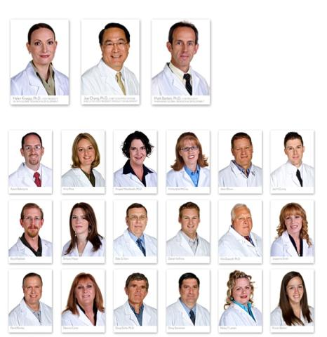
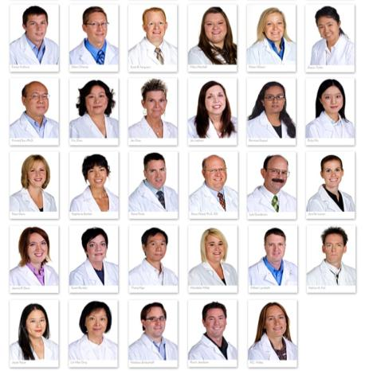
WORLD CLASS SCIENTISTS
WITH AN ARRAY OF EXPERTISE
Notes:
Nu Skin has a team of in-house scientists. We demonstrate our commitment to research and development by collaborating with multiple leading research institutions. These collaborative relationships help us develop an enhanced understanding of the genetic basis of aging.

Slide 5




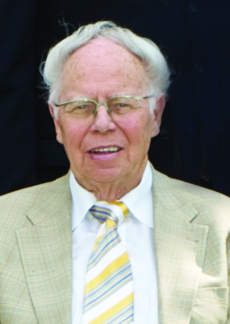
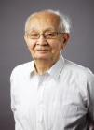








WORLD CLASS
SCIENTIFIC ADVISORY BOARD
A. Kimball
Harvard Dermatologist
C. Djerassi
Stanford
Father of oral contraceptives
D. Bearrs
Huntsman Cancer Center
Pioneer in Cancer genetics
G. Halperin
Pioneer in Immunology
H. Wagner
Pioneer in Phytomedicine
K. Nakanishi
Father of Ginko
L. Bohlin
Pioneer in Natural Products
L. Mitscher
Pioneer in Green Tea
L. Packer
Father of antioxidants
M. Kuro-o
Discoverer of Klotho aging gene
M. Wanner
Harvard Dermatologist
P. Cox
Pioneer in Ethnobotany
R. Weindruch
Pioneer in Aging Research
T. Prolla
Pioneer in Aging Research
Z. Draelos
Duke Dermatologist
Notes:
The Nu Skin Anti-Aging Scientific Advisory Board brings together the best minds in research in the areas of skin care, nutrition, genomics, and bioinformatics.

Slide 6
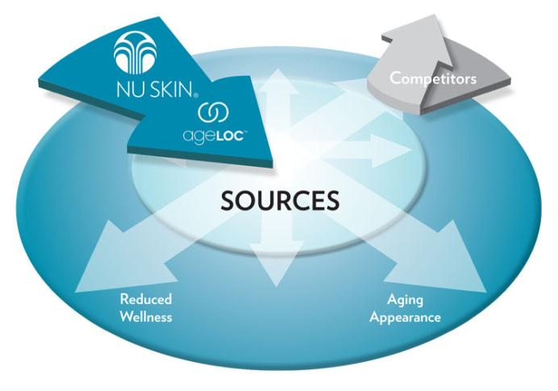
COMPETITIVE ADVANTAGE
TARGETING THE SOURCES OF AGING
Notes:
Competitors in the skin care and nutrition industries merely address the signs and symptoms of aging, such as an aging appearance or reduced wellness. Nu Skin’s anti-aging science targets the sources of aging, not just the symptoms.

Slide 7
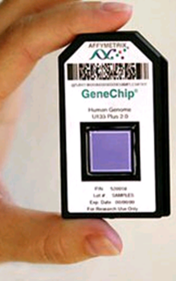

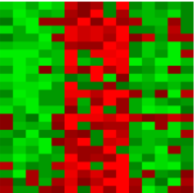
GENE CHIP TECHNOLOGY
Small set of robust biomarkers for rapid screening of nutrients and phytochemicals
DNA Microarray Gene Map
Over 20000 Genes
Notes:
The first step in our innovative anti-aging science is to identify the clusters of genes (YGCs) that are linked to aging. We do this through state of the art gene chip technology. Each of the tiny dots you see here represents the gene expression activity of each of the approximately 20,000 genes in the human genome. In some applications the chip contains triplicates for each gene giving us the results of more than 60,000 chemical reactions - each of which could take hours of one technician’s time to perform. That’s either 60,000 technicians working for hours or one technician working non-stop without sleep for 27 years….for information on just one experimental condition. The gene chip allows us to do what was not even comprehensible just 10 years ago.

Slide 8
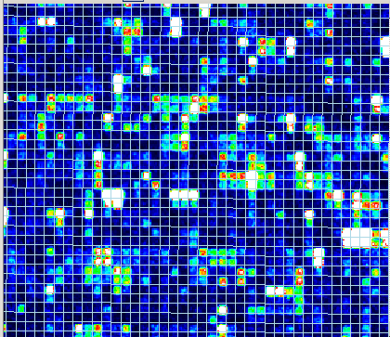
GENE CHIP TECHNOLOGY
Notes:
Here is a closer look at the gene chip. Each square is a reaction chamber. Some squares are dark, some brighter, some red. The brighter and redder squares indicate that the gene represented in that square is more active.

Slide 9
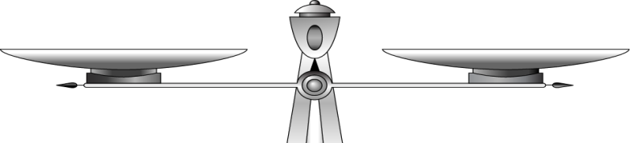
ITS ALL ABOUT BALANCE
Factors influencing signs of aging
Factors influencing signs of youth
Anti-Aging Science
Anti-aging science
Notes:
The key is to use the gene activity to identify those genes that may affect aging. When you’re born, genes express themselves in a youthful manner. But aging and years of interacting with the environment cause some genes in your YGC’s to turn up and some to turn down. Our goal is to understand youthful gene expression patterns.

Slide 10
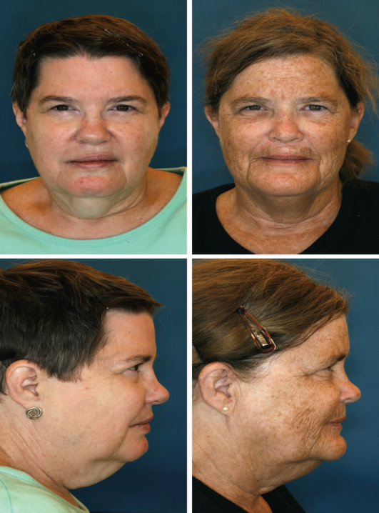
IDENTICAL TWINS AGE AT DIFFERENT RATES Add Reference
Guyuron B, Rowe DJ, Weinfeld AB, Eshraghi Y, Fathi A, Iamphongsai S. Factors contributing to the facial aging of identical twins. Plast Reconstr Surg. 2009 Apr;123(4):1321-31.
Notes:
In this example you can see the difference between overall gene expressions giving a more youthful appearance (on the left) compared to that of a more aged appearance (on the right). These are identical twins. The clearly-visible differences seen are in response to lifestyle choices like nutrition, sun exposure etc. We look to influence the expression of YGCs back toward youthful patterns.

Slide 11
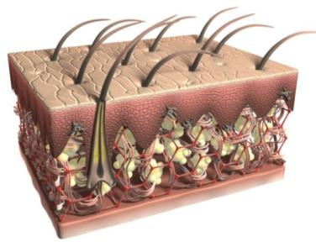
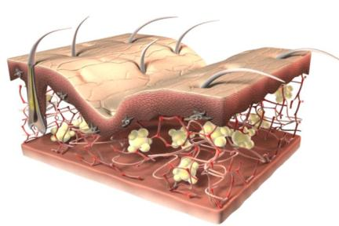
CHARACTERISTIC FEATURES
OF SKIN AGING
Notes:
Looking more closely at aging facial skin, compare the youthful skin on the left to aged skin on the right After we reach the age of 30-35, our resilient and firm skin starts to give way to a sagging and wrinkling appearance. The support structure for the skin becomes weak and disorganized. Skin is no longer adequately supported or able to retract to its original young, firm state.

Slide 12
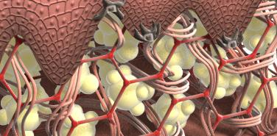
BREAKDOWN OF PROTEINS
Skin Proteins
Notes:
A significant contributor to an aged skin appearance is the destruction of important skin proteins like elastin and collagen.

Slide 13
FIRMING FOCUSED YGC*
ANTI-AGING SCIENCE
Skin Structure
Firming
Improves Sagging
Contours
Defines
*A subset of the Skin Structure YGC
Notes:
We use Nu Skin’s proprietary anti-aging science to identify groups of genes, YGCs, that can be influenced to provide a more youthful expression pattern. Here a subset of the Skin Structure YGC that contributes to skin firming.

Slide 14




NU SKIN EXCLUSIVE ACQUISITION
Notes:
Recently, Nu Skin purchased LifeGen Technologies, which gives us more than 30 years of research into the genetic basis of aging. Ownership of LifeGen’s pioneering research combined with Nu Skin’s ongoing research allows us to develop innovative proprietary products far into the future.

Slide 15
NOX TECHNOLOGIES ACQUISITION
Patented anti-aging technology
Incorporated in ageLOC Transformation and Spa Gels
Anticipated acquisition Q4 2012
Notes:
Nu Skin has also entered into an agreement to acquire NOX Technologies. NOX Technologies provided Nu Skin scientists with an initial understanding of the aging process and supports the company’s ability to understand important sources of aging. We believe the acquisition will enhance our long-term pipeline of scientifically validated anti-aging solutions for health, beauty and wellness.

Slide 16
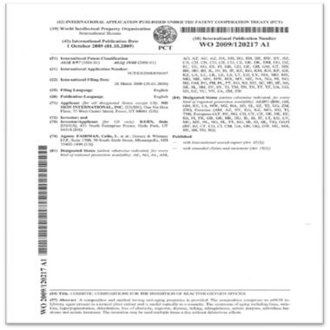
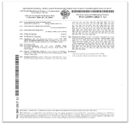
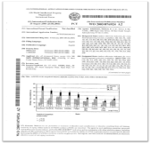
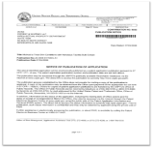
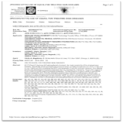
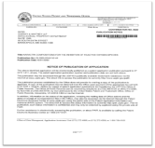
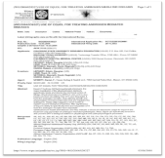
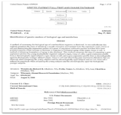
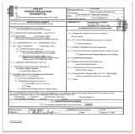
PATENTS PROTECT OUR INNOVATIONS
Anti-Aging Science
Anti-aging science
Notes:
We file patents on our discoveries.

Slide 17
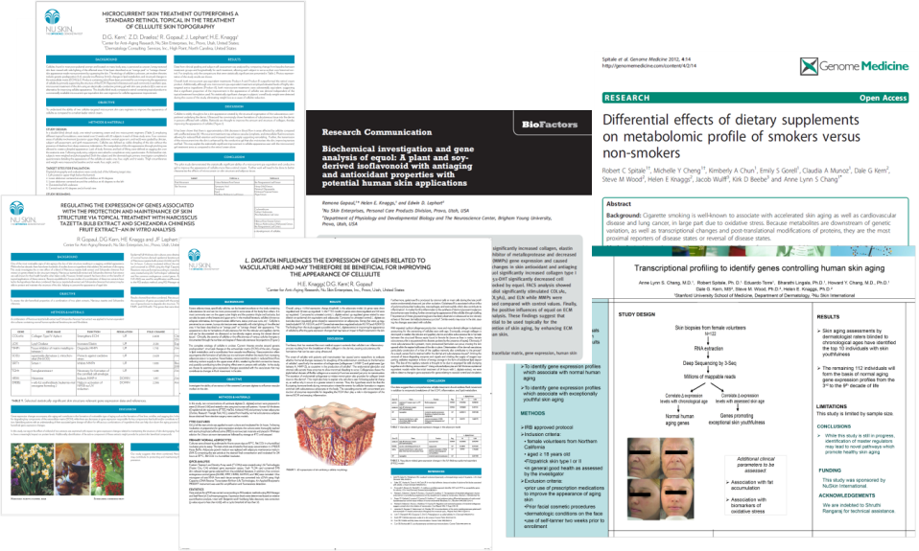
PUBLICATIONS
Anti-Aging Science
Anti-aging science
Notes:
And then we publish and present our findings and discoveries to the scientific community.

Slide 18
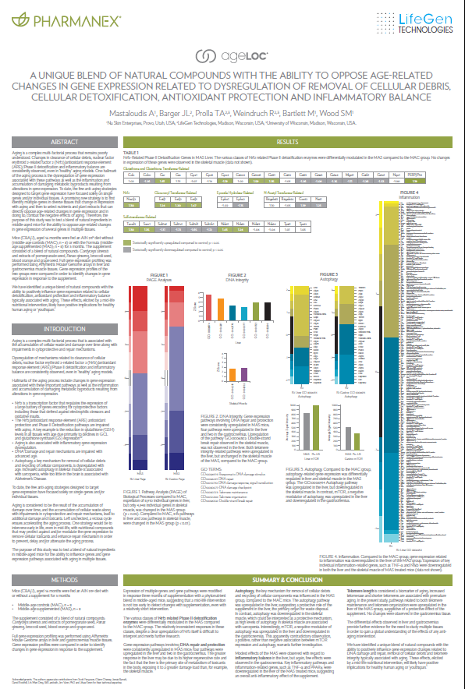
EXCLUSIVE & PROTECTED
18 Patents filed or pending
8 Articles published
14 Oral presentations
26 Scientific posters
3 Prestigious awards
Notes:
For example, here is an early summary as of the beginning of 2012, and that’s just the beginning.

Slide 19
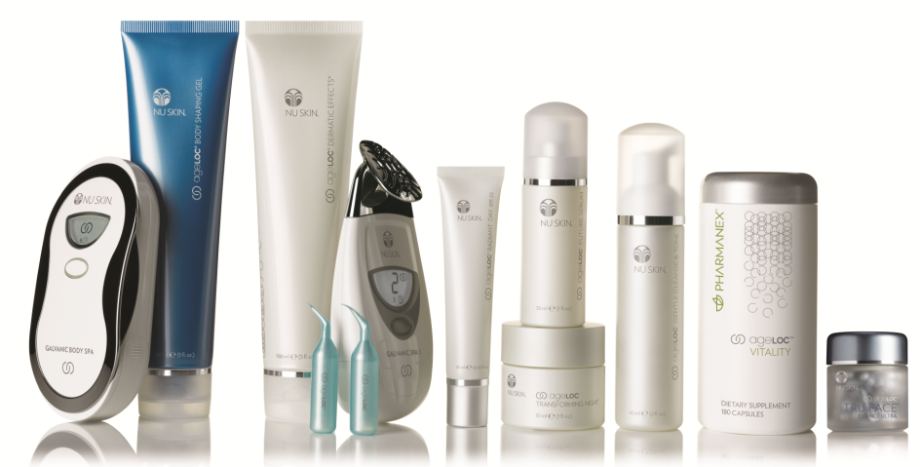
AGELOC IS A PROVEN BRAND
OVER $1 BILLION
IN AGELOC SALES
SINCE Q4 2009
Notes:
ageLOC is a proven platform for growth. The launch of Nu Skin’s most advanced anti-aging skin care system, ageLOC Transformation, broke record global convention sales in the 4th quarter of 2009. The ageLOC product offering continues to grow with the launch of ageLOC Vitality which targets and resets important YGCs to help you feel younger, healthier, and more vibrant, Since the launch of ageLOC Transformation, ageLOC product sales have passed $1 billion globally!

Slide 20
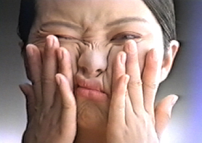
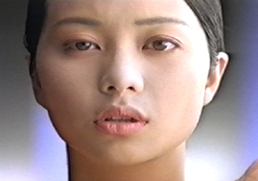
YOUTHFUL SKIN
“SNAP BACK” QUALITY
Notes:
Youthful skin has the ability to stretch and bounce back. As we age, however, the “snap back” elasticity of the skin begins to diminish. This causes the skin to lose contour and firmness and start to sag. You’re all familiar with the benefits of using Tru Face Essence Ultra.

Slide 21
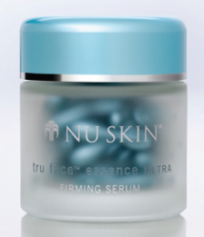
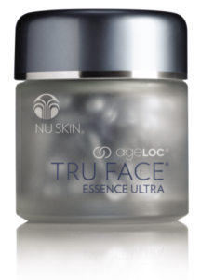
ALL THE SAME GREAT BENEFITS PLUS…
Contains Ethocyn®, clinically proven to improve the key component of firm skin
Study participants averaged 166% increase in elastin with a twice-daily application of Ethocyn*
Helps contour and firm the skin for a more youthful appearance
Defines skin around the eyes, neck, chin, and jawline
Helps protect the skin from oxidizing free radicals
Targets the sources of aging
Contains ageLOC Proprietary Blend
More firming ingredients
Continuous improvement in overall skin firmness
Consumer feedback: it feels better on the skin
Majority of people saw results in one week**
Notes:
So let’s review those now:
Contains Ethocyn®, clinically proven to improve the key component of firm skin
Study participants averaged 166% increase in elastin with a twice-daily application of Ethocyn*
Helps contour and firm the skin for a more youthful appearance
Defines skin around the eyes, neck, chin, and jawline
Helps protect the skin from oxidizing free radicals
As we continue to apply innovation to our products we’ve innovated with our exclusive anti-aging science, and now we provide all the same great benefits plus:
Targets the sources of aging
Contains ageLOC Proprietary Blend
More firming ingredients
Continuous improvement in overall skin firmness
Consumer feedback: it feels better on the skin
Majority of people saw results in one week

Slide 22
CLINICAL STUDY improvement over baseline
66%
53%
55%
44%
41%
30%
21%
18%
Notes:
A third-party contract research organization recruited 30 subjects who showed mild to moderate signs of aging (specifically lack of skin firmness) to use ageLOC Tru Face Essence Ultra twice daily for 12 weeks. By week 12, impressive percentage improvements over baseline were seen: 53% improvement in overall skin firmness, and 66% improvement in firmness around the eyes.

Slide 23
CLINICAL RESULTS
Percent of Subjects
80%
80%
These results represent the highest response to a Tru Face Essence product that Nu Skin has ever seen in these time frames!
55%
55%
Notes:
In the same study, we were surprised at how early our subjects saw benefits. In fact, they could start to see benefits in one week! Over 55% of the subjects reported improvements both in overall firmness and in firmness around the eyes. By week 12, an impressive 80% of subjects were showing improvements in these same areas.

Slide 24
CLINICAL RESULTS
Number of years younger subjects reported for skin appearance at week one
Notes:
Throughout the study, subjects were asked how much younger they looked at each time point:
Amazingly, 100% of the subjects reported their skin looked younger within one week. It was striking to see that over 30% of subjects reported that their skin looked 3 or more years younger just by using ageLOC Tru Face Essence Ultra in one week.
15% of subjects felt their skin looked 10+ years younger at week 12

Slide 25
Leave undefined skin in the past and enjoy firmer, younger looking skin today and in the future, with ageLOC Tru Face Essence Ultra.
Notes:
Leave undefined skin in the past and enjoy firmer, younger looking skin today and in the future, with ageLOC Tru Face Essence Ultra.

Slide 26
Notes:
Doctor Helen Knaggs and Nu Skin Scientist, Dale Kern, thank you for sharing this information. This completes the ageLOC Tru Face Essence Ultra presentation. Thank you for joining us.

