Slide 1
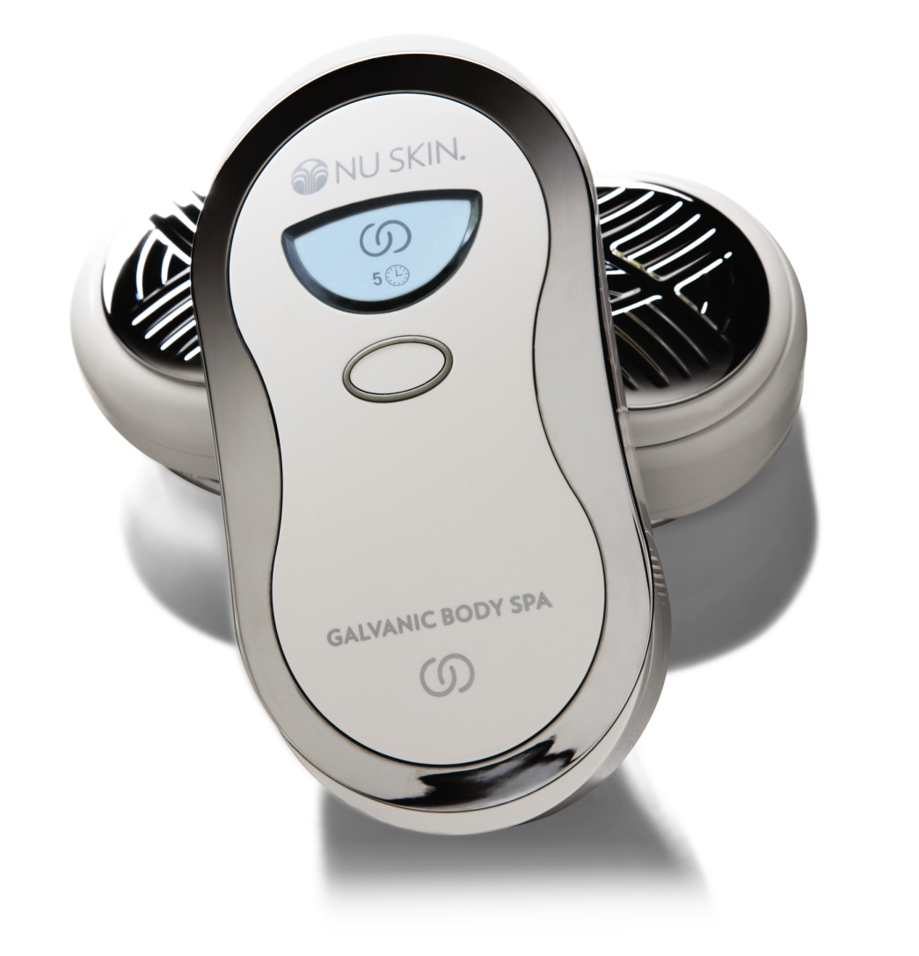
ageLOC®
Galvanic Body Spa

Slide 2
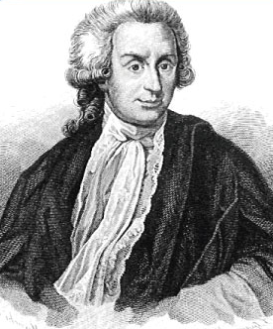
The History of Galvanic Current
The “galvanic current” used today for cosmetic benefits is named after the Italian scientist, Luigi Galvani who, in 1791, discovered that the body conducts electric currents.

Slide 3
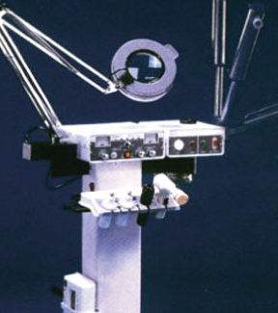
What Is a Galvanic Treatment?
For several decades, spa and salon professionals have used gentle galvanic currents in customized treatments to refresh and energize the skin. These treatments require a trained esthetician who uses a large machine with a roller that provides a gentle massaging action to help focus cellular energy and enhance circulation to improve skin clarity and complexion.

Slide 4
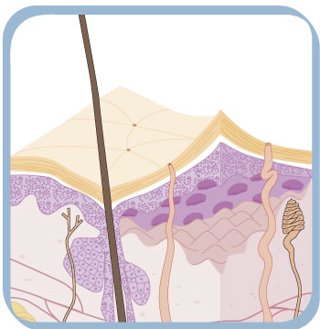
How Does a Galvanic Treatment Work?
-
Galvanic treatments use the basic principles that like charges repel each other and opposites attract—similar to magnetic poles.
Products are formulated to contain key ingredients which carry a positive or negative charge. The instrument is also set to have the same charge as key ingredients in the product. The repelling of like charges “pushes” or facilitates the delivery of key ingredients to the skin.
The negative charge of the ageLOC Galvanic Body Spa pushes the key ingredients in the ageLOC Body Shaping Gel to the skin.
-
-
-
+
+
+
+

Slide 5
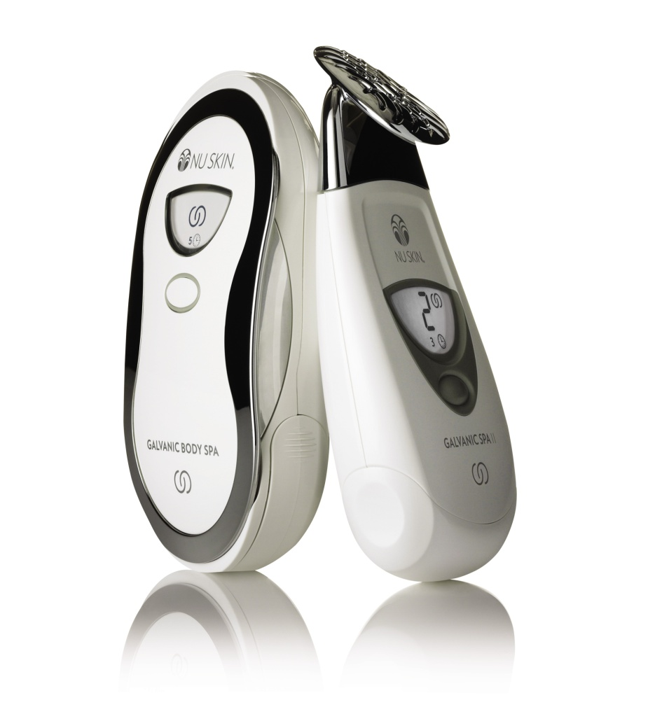
Pulsating Galvanic Currents
Pulsating direct currents, as delivered by the ageLOC Body Spa, are more appropriate for treating the thicker layers of skin on the body that are affected with the appearance of cellulite and lack of firmness.
Constant direct currents, as delivered by the ageLOC Face Spa, are best suited to treat the thinner more sensitive layers of skin on the face, where cellulite is not prevalent.

Slide 6
Pulsating Galvanic Currents
While a constant galvanic current is one that has a steady flow—it does not waver or vary in amplitude*—a pulsating galvanic current is one type of direct current (DC) that varies between two different, pre-established levels.
Constant
Direct
current
* A pulsating galvanic current is NOT an alternating current (AC). Within alternating currents, the polarity fluctuates between positive and negative poles.

Slide 7
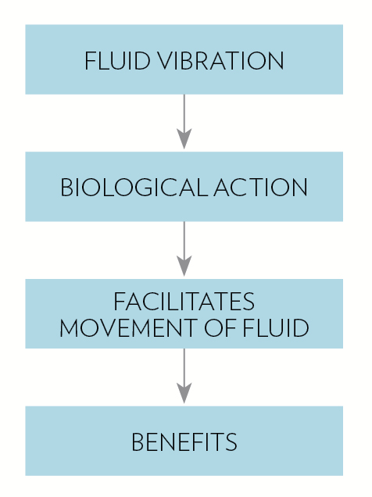
Pulsating Galvanic Currents
Pulsating direct currents can cause physical stimulus which results in improved blood flow and movement of fluids. Enhanced blood flow more efficiently removes waste and allows more nutrients to be delivered to skin cells, resulting in a youthful, radiant appearance.

Slide 8
ageLOC Galvanic Body Spa
Your body optimized.
Newly developed, patent-pending galvanic pulsating technology is optimized to maximize anti-aging effects on the arms, abdomen, buttocks, and thighs.

Slide 9
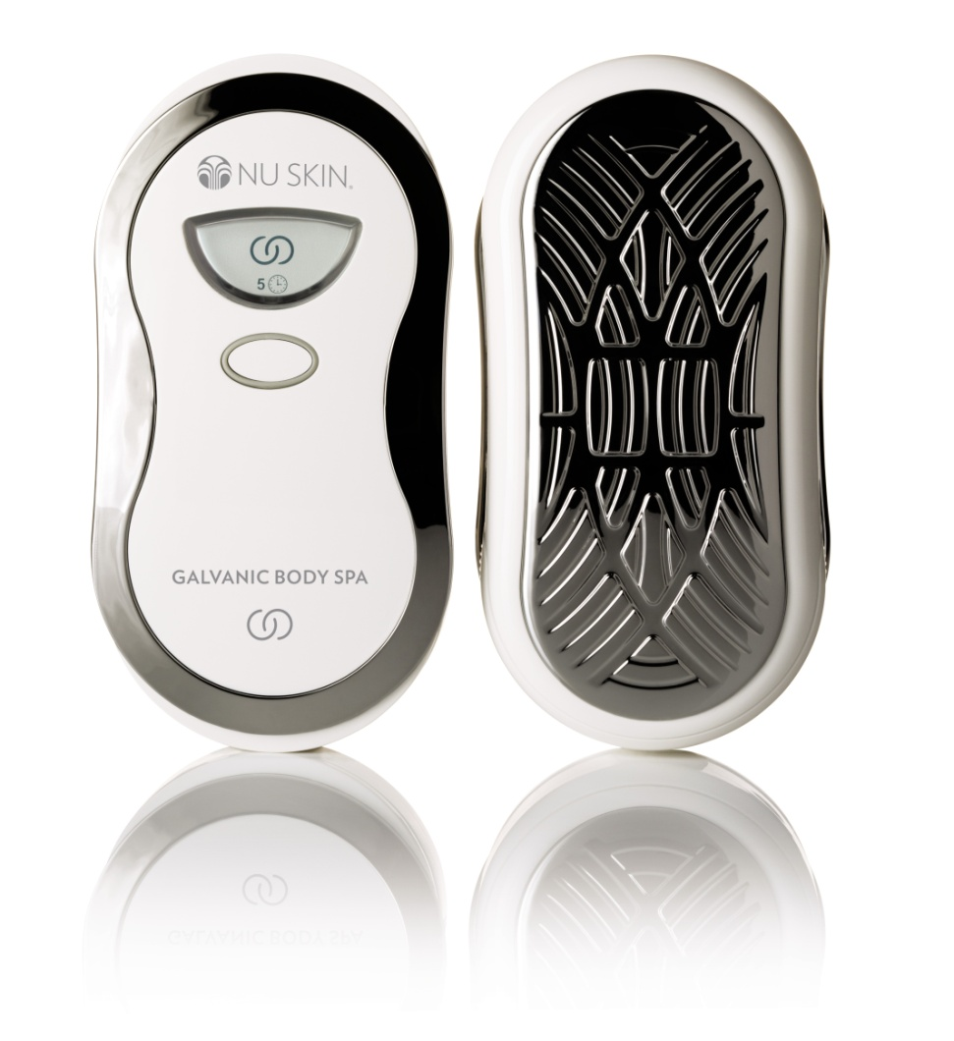
Enhanced Features
The ageLOC Body Spa features a larger proprietary ageLOC conductive surface, which is able to maintain 10 times more product between the skin and the instrument surface, delivering more key ageLOC ingredients to the skin (when compared to the body conductor attachment).

Slide 10
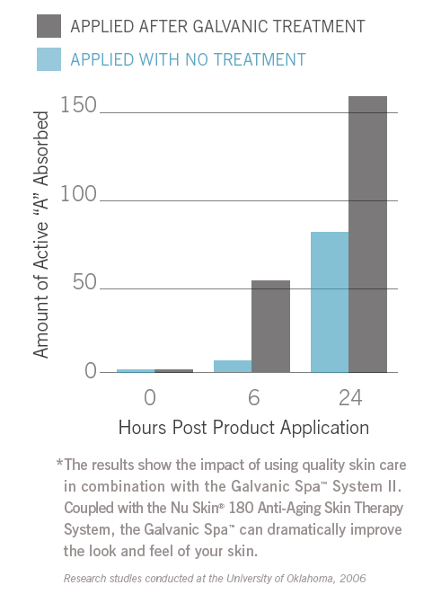
Lasting Benefits
Carefully controlled research reveals that galvanic treatments enhance the delivery of key ingredients for up to 24 hours following galvanic treatment, including active ingredients contained in subsequently applied advanced anti-aging products.

Slide 11
ageLOC Body Shaping Gel
For a slimmer, firmer, smoother you.
ageLOC Body Shaping Gel is formulated to work with the ageLOC Galvanic Body Spa. It is an intensive spa quality product that minimizes and smooths the appearance of fat and cellulite, improves the appearance of skin’s firmness, and helps improve the overall appearance of the skin.

Slide 12
ageLOC Dermatic Effects
For a more contoured, smoother looking you
After using ageLOC Body Shaping Gel and Body Spa, complete the regimen by smoothing on ageLOC Dermatic Effects. (ageLOC Dermatic Effects should not be used with the Body Spa.)
This daily moisturizer compliments the Body Spa regimen and helps provide additional benefits of smoothing the appearance of fat and cellulite and improving the appearance of skin firmness.

Slide 13
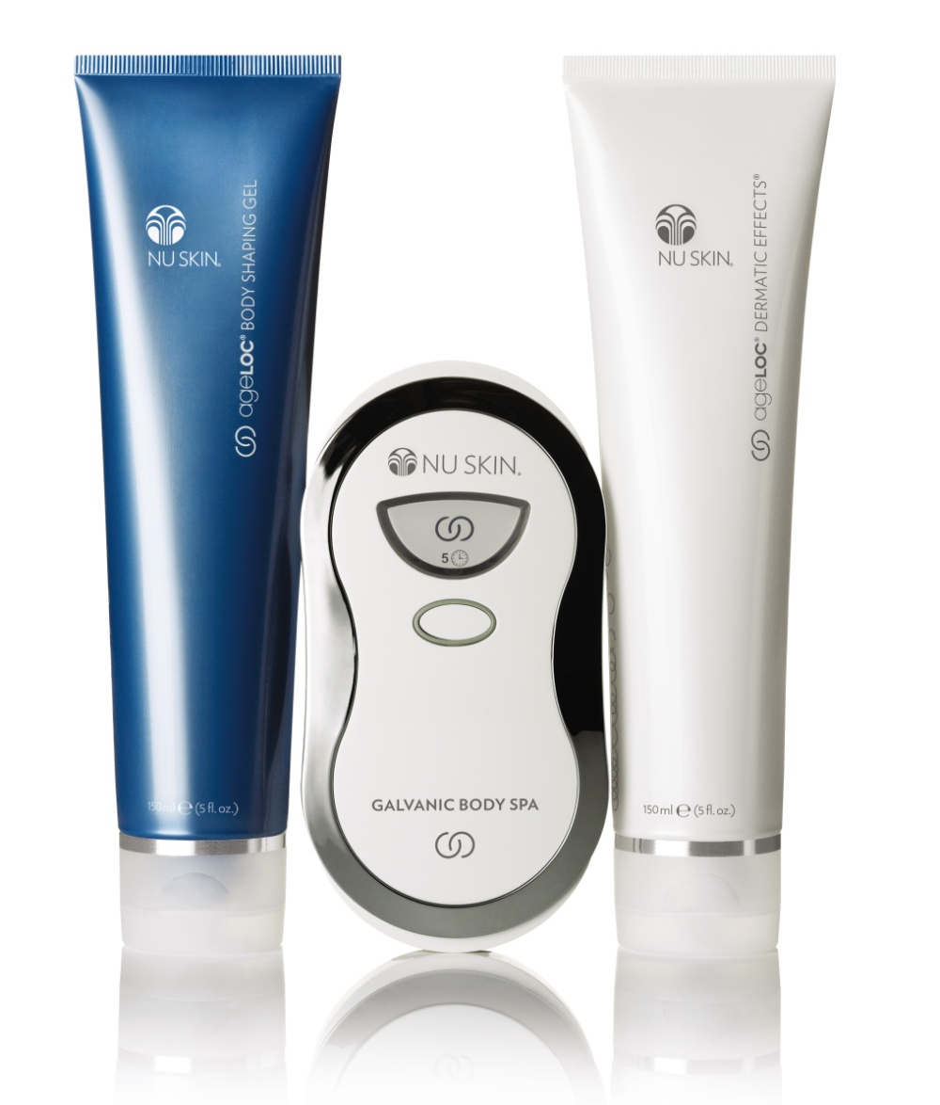
Usage
For optimal results, use your ageLOC Galvanic Body Spa with ageLOC Body Shaping Gel three days per week on thighs, arms, buttocks and/or abdomen.
After completing your ageLOC Body Spa regimen, apply ageLOC Dermatic Effects twice daily, morning and night.

