Slide 1
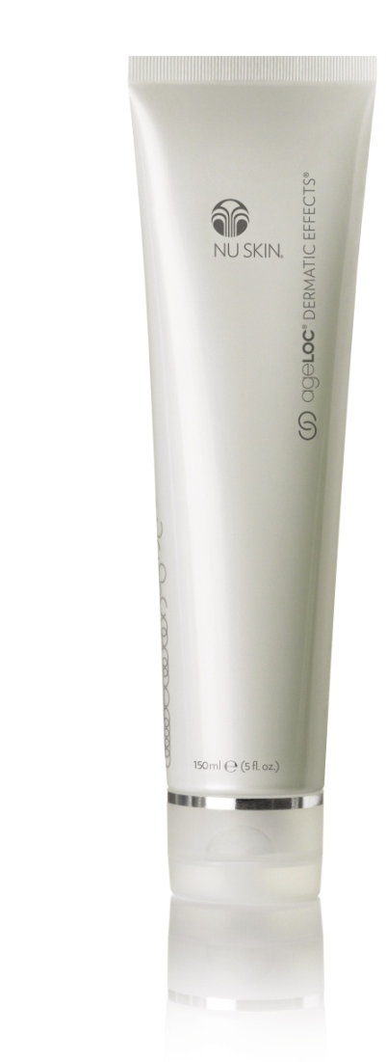
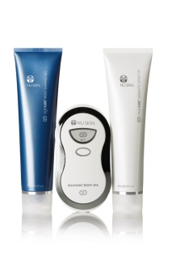
ageLOC®
Dermatic Effects
Body Countouring Lotion

Slide 2

Introduction
Like other organs of the body, the physiological functions and structures within the skin continuously decline with aging.
Most individuals focus on the appearance of their facial skin, but the skin on the body also shows signs of aging.

Slide 3
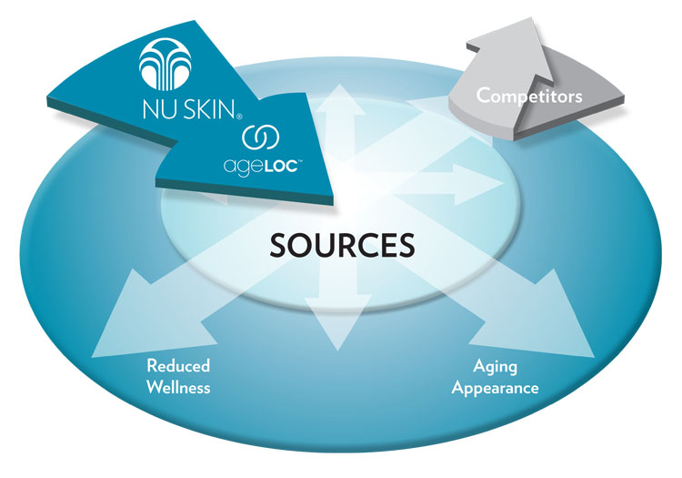
Ultimate Sources of Aging
Aging can ultimately be linked back to genes. The expression of our genes is a contributing factor to aging. A person’s genetic makeup and gene expression profiles, combined with many other aging factors, including environmental exposure, determines the way he or she will age—both internally at the cell level and externally by skin appearance.

Slide 4
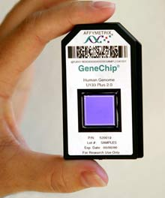
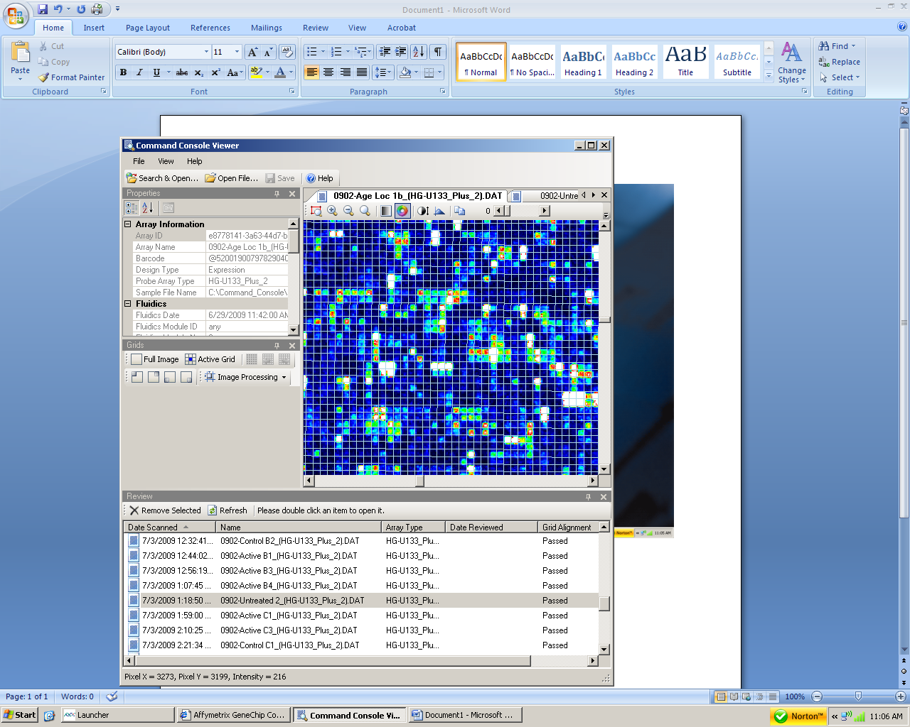
Youth Gene Clusters
Based on an understanding of the human genome, Nu Skin scientists have been able to identify through proprietary ageLOC science, key Youth Gene Clusters (YGCs) that affect aging.
YGCs are functional groups of genes whose expression can be regulated to provide a youthful gene expression profile of a specific attribute.

Slide 5
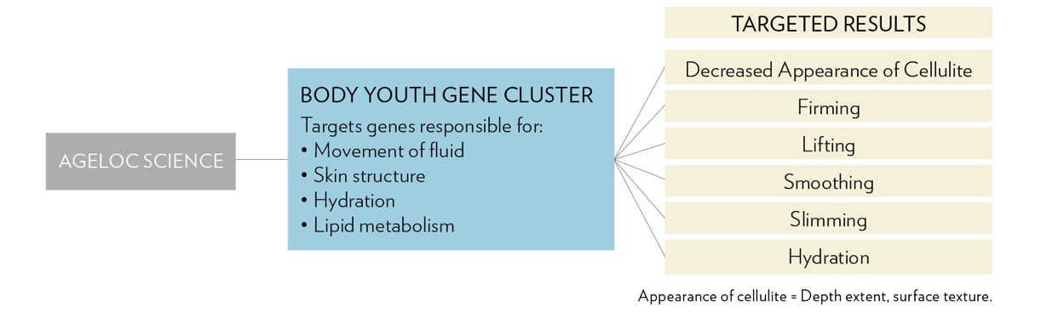
Body Youth Gene Cluster
Through continuing innovation, Nu Skin scientists have now identified a Body YGC for the skin.

Slide 6
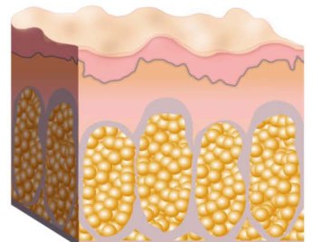
Science of Cellulite
  Cellulite is a protrusion of fat into the dermis that is visible topically and results in a dimpled appearance.
Cellulitic Skin
Thin
Thick

Slide 7
ageLOC Dermatic Effects
For a more contoured, smoother looking you
Scientifically formulated to bring ageLOC anti-aging benefits to the body every day, ageLOC Dermatic Effects helps smooth the appearance of fat and cellulite and improve the appearance of skin firmness.

Slide 8

Key Benefits of ageLOC Dermatic Effects
ageLOC targets the ultimate sources of aging
Helps inhibit fat production and stimulate fat breakdown
Helps smooth the appearance of fat and cellulite
Improves appearance of skin’s firmness
Helps increase cellular turnover
Leading technology diffuses light to improve the appearance of the skin’s surface.
Hydrates and helps smooth the skin.

Slide 9

Key Ingredients of ageLOC Dermatic Effects
ageLOC®—proprietary Nu Skin® technology that targets the ultimate sources of aging.
Hibiscus abelmoschus extract—has been found to stimulate the breakdown and inhibit the production of fat.
Honey extract—a natural alpha-hydroxy acid to help smooth and soften skin.
Hyaluronic acid—helps maintain an optimal moisture level.

Slide 10
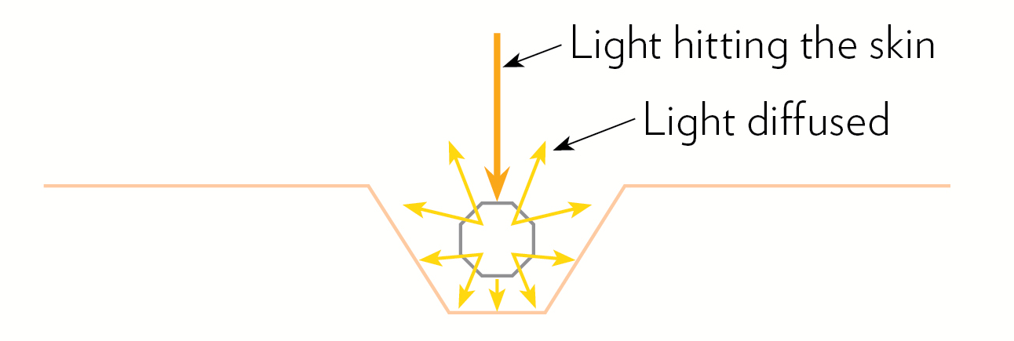
Key Ingredients of ageLOC Dermatic Effects
Leading edge optical technology diffuses light instantly to help skin look smoother and improve the appearance of the skin’s surface.
When the skin’s surface is uneven, light is not reflected uniformly and shadows are cast allowing the eye to see the varying topography. By utilizing anti-shine ingredients that flatten and diffuse light in multiple directions, the skin instantly appears smoother. This optical treatment visually improves the appearance of the skin’s surface.

Slide 11
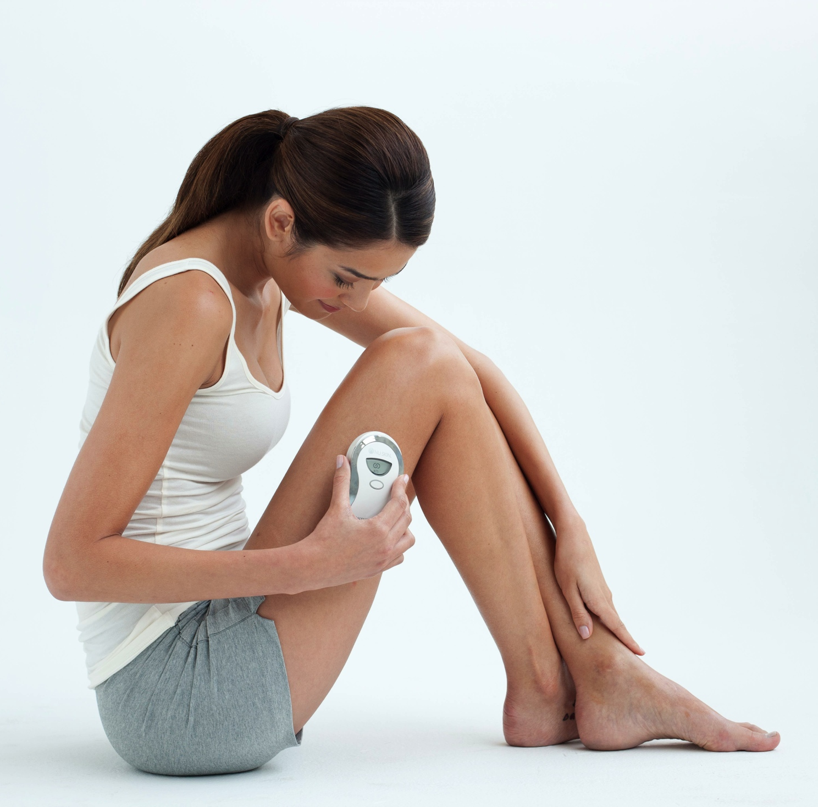
Usage
Apply twice daily, morning and night to arms, thighs, buttocks, and/or abdomen. For best results combine with your ageLOC Body Shaping Gel regimen.

Slide 12


